Slide 1

SMILE partner schools
‘Train the trainer’ session

Slide 2
Trainer’s information:
Prior to training staff complete coping survey and WEMWBS.
Information here is organised into suggested sessions, designed to pick up and use but which can be adapted and extended to meet individual school needs.
If schools would like support or information & training with other areas from Forest Oak/Merstone please contact Issy Jerrard
Forest Oak example:
Training sessions for your school
(Suggested)
Whole school inset sessions 1& 2 (am)
wellbeing for staff (pm)
Auditing provision and SMILE activity Planning (staff meetings sessions 3& 4)
Additional sessions through staff meetings: e.g. Using CBT, mindfulness for staff, using coping scales in PHPs, sharing good practice amongst teams
Embedding with pupils through assemblies, national EHWB awareness days, arts week and taught sessions
1-info about EHWB, risk factors, common MH conditions
2-protective factors, coping strategies, 5 ways to wellbeing & SMILE
3-auditing current practice & SMILE materials for use with pupils (see packs for schools)
4-planning a whole school SMILE launch with targeted pupils & activities
Notes:
Information with purple headings is intended for trainer/s only
Sessions 1 and 2 could take a whole day depending on school’s previous training.
Sessions 3 & 4 are suggested to give a framework but SMILE approach project is individual schools-needs led and should be dependent on what your staff want/need next.
Please refer to timeline to ensure auditing & planning is completed and returned.

Slide 3
EHWB assessment evidence
Pupils
Staff
WEMWBS
(adapted versions for
students with MLD
or SLD; wellbeing
assessment of pupils with
PMLD is observational)
*SLD schools discuss at end*
Coping strategy survey
WEMWBS (online) – search ‘NHS WEMWBS self-assessment’ or click on https://www.nhs.uk/tools/documents/self_assessments_js/assessment.html?XMLpath=/tools/documents/self_assessments_js/packages/&ASid=43&syndicate=undefined
To print paper versions:
https://www.nhs.uk/Tools/Documents/Wellbeing%20self-assessment.htm
Coping strategy survey
IJ will email coping strategy surveys to schools & summary sheets.
ensure staff made aware to seek support if highlights difficulties e.g. Solihull schools: https://www.well-online.co.uk/
https://www.educationsupportpartnership.org.uk/helping-you
Notes:
Staff online version is here
Need to have system of recording scores anonymously.
Forest Oak coded each and in repeated versions staff selected same code.
Could complete coping survey with code on and then add wemwbs online score to bottom.

Slide 4
School:
Date:
Trainer:
Notes:
From this point these are sessions to use (and adapt if needed with your school.)

Slide 5
Whole school session 1
Before we start….
Staff WEMWBS click on
https://www.nhs.uk/Tools/Documents/Wellbeing%20self-assessment.htm
Paper version
https://www.nhs.uk/tools/documents/self_assessments_js/assessment.html?XMLpath=/tools/documents/self_assessments_js/packages/&ASid=43&syndicate=undefined
Staff Coping strategy survey (add your WEMWBS score to it.)These are anonymous, not shared outside of the project team and only individually coded to compare before and after project findings
NOTE ADVICE or SEEK SUPPORT FROM SLT/MHFA WITHIN SCHOOL IF AT ALL WORRIED ABOUT YOUR SCORE
Solihull schools: https://www.well-online.co.uk/ username:sbclogin password:wellbeing
Notes:
In order for all to be anonymous but able to be evaluated each form should be coded e.g. initials of school FO 12 number or letter/number and staff take same code for both and remember/record somewhere so each can be compared before and after project input.
All will be confidential and stored securely.
Leads to complete the staff summary sheet as process to review own staff responses and then send summary to Issy
Staff do not need to share code with anyone but know how & be encouraged to seek support in school or through colleague assist programme if highlights low scores. Some staff may want to discuss results with SLT/EHWB lead.

Slide 6
Whole school session 1
Hoped for Outcomes
Introduce SMILE project principles & aim
Increased knowledge and understanding around mental health
understand how we can support children and young people to be mentally healthy
Introduce a process for supporting children and young people who are experiencing difficulties (ALGEE)
Notes:
This session designed to last ½ morning but adapt as needed

Slide 7
Principles
For all – children, staff and the whole school community
Attainment – good mental health leads to good life outcomes
Listening to each other
Care, concern and respect for everyone
Kindness and gratitude
Notes:
This values base is common to every human being in the school; it frames how we are evaluating SMILE.
The SMILE approach is an operational framework for supporting children’s Emotional Health and Wellbeing. It is a way of thinking about Emotional Health and Wellbeing. It offers a strong perspective including an ethos and purpose, and is a way of bringing coherence to the multiplicity of Emotional Health interventions in schools. It also ensures that the 5 ways to mental health and wellbeing promoted by the NHS are always in mind, easily kept in mind, and have equal priority.

Slide 8

SMILE aim
“To empower our school communities (staff and students) to become ‘architects of their own emotional health and well-being’ within an enabling environment. “
Notes:
The Emotional Health and Wellbeing of young people is paramount to their ability to learn and apply themselves fully. Research and good practice in schools demonstrate that when staff and pupils feel good about themselves, they perform better. Personal feelings affect behaviour, motivation, relationships, health and social development. For staff, a positive sense of well-being can result in higher levels of tolerance, enthusiasm, energy and interest and lower levels of absence or stress. The same is true for pupils, leading to better learning outcomes, improved attendance and more positive behaviour. A pupil is unlikely to be able to learn effectively if their basic needs for safety, belonging and self-esteem are not met. Equally, if unaddressed, the persistent nature of consistently poor behaviour can have a negative effect on the morale of both staff and pupils.

Slide 9
Why whole-school?
‘NICE advises schools should be supported to adopt a whole school approach to promoting the social and emotional wellbeing of children and young people….Such an approach moves beyond learning and teaching to pervade all aspects of the life of a school, and has found to be effective in bringing about and sustaining health benefits.’
Public Health England (2015) Promoting Children and Young People’s Emotional Health and Wellbeing.

Slide 10
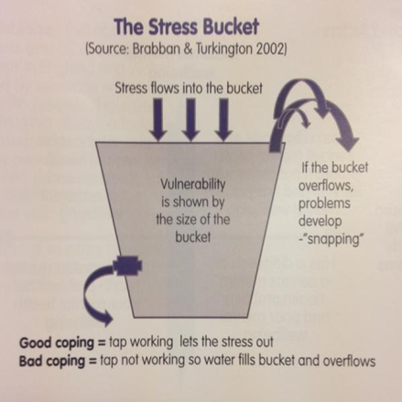
Why ‘for all?’
Prioritising wellbeing for everyone
Improve support to pupils by increasing knowledge
Increase confidence in responding to EHWB needs
Reduce stigmas associated with talking about EHWB
opportunity to identify strategies to actively improve our own EHWB
Model to pupils healthy coping strategies and attitudes
Staff have ownership and interest in an approach led by their school community needs
Notes:
https://youngminds.org.uk/resources/school-resources/caring-for-the-wellbeing-of-teachers-and-school-staff/#the-causes-of-stress-among-teachers
(See later info about staff wellbeing)

Slide 11

Notes:
How we think about children’s mental health shapes how we work with children. Our own experiences, assumptions and knowledge may lead us to see ‘mental health’ as a specialist field that is the province of psychologists and psychiatrists and nothing to do with teaching. Alternatively, we may think of mental health in terms of a continuum which all of us are part of and which we move backwards and forwards across at different points in our lives. In this view children’s mental health is not a specialist field, but the concern of everyone in contact with children and central to the role of schools.
‘Mental Health and Behaviour in Schools, Departmental advice for school staff’ (March 2016) outlines that ‘schools have a role to play in supporting their pupils to be resilient and mentally healthy.’
‘There is evidence to show that staff without a mental health background, including teachers, can be trained to deliver some specific interventions, with outcomes comparable to mental health professionals.’ For emotional disorders such as anxiety and depression, group cognitive behavioural therapy (CBT) in a school setting has been shown to reduce depressive symptoms, and symptoms of anxiety. Government Green paper, 2017.

Slide 12
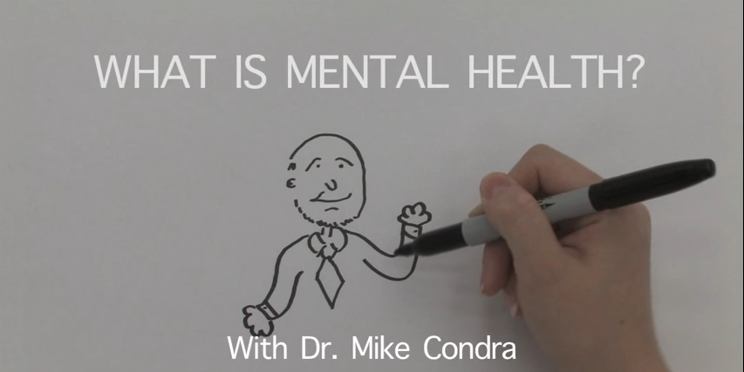
Notes:
There is broad agreement that mental health is more than the absence of illness and that it includes a positive concept of wellbeing. This challenges the idea that mental health is the opposite of mental illness and encourages consideration of alternative models. “Mental health influences how we think and feel, about ourselves and others, and how we interpret events. It affects our capacity to learn, to communicate and to form, sustain and end relationships. It also influences our ability to cope with change, transition and life events”1. It is therefore ‘everybody’s business’. All services working with children, young people, families and carers should be aware of their role in relation to mental health and their impact on the children with whom they have contact. Schools are particularly important and have huge potential to have a positive influence on children’s developing mental health.
‘Experiencing mental health concerns is not unusual. At least one in four of the population experience problems at some point in their lives. Over half of mental health problems in adult life (excluding dementia) start by the age of 14 and seventy-five per cent by age 18. Although mental health issues are relatively common, it is often the case that children and young people don’t get the help they need as quickly as they should. As a result, mental health difficulties such as anxiety, low mood, depression, conduct disorders and eating disorders can stop some young people achieving what they want in life and making a full contribution to society.’ Department of Health and NHS England (2015). Future in Mind: promoting, protecting and improving our children and young people’s mental health and wellbeing. Available at: https://www.gov.uk/government/uploads/system/uploads/attachment_data/file/414024/Childrens_Mental_Health.pdf

Slide 13


Word association Activity
Mental health
Mental illness
Notes:
This activity aims to consider any stigmas and negative issues regarding EHWB by considering the term ‘mental health.’ Ask staff to add words to each paper, including past terms or stereotypes.
Mental health is not a neutral term, but one that has associated with it a range of, sometimes negative, connotations in the minds of the general public, parents and carers, practitioners and children and young people themselves. What we understand by mental health will depend on our values, preconceptions and assumptions, for example about the nature of health and illness, the nature of society, the place of the individual within society, what constitutes normality, desirable behaviour and attitudes and so on. Reflecting on the basis of our own understanding of the terminology can be a useful precursor to engaging in discussion with others about their concept of mental health.
There is good evidence that children’s mental, emotional, physical, psychological and social wellbeing are intimately interrelated and that good mental health substantially underpins children’s capacity for learning. Practitioners from different disciplines may understand the term mental health differently from each other, or may use different terms such as ‘emotional health and well being’ or ‘social and emotional health’ to describe very similar things. Where these differences are openly discussed they can prove to be a valuable resource, encouraging new insights and creative ways of working together. Where the differences are not explored they can lead to duplication, conflicts and missed opportunities. A shared understanding of ‘what is mental health’ is a necessary step towards a shared approach to meeting children’s needs.

Slide 14
Terminology
MHWB
EHWB
EWMH
SEMH
(Code of Practice)
ETC...
EWB/MH
Partner schools may have their own preferred abbreviation
Notes:
Defining mental health in children and young people is not easy. In many respects the debate about what is meant by this and associated terms is as important as the conclusion. Through discussion locally, teachers, school support staff and school leaders can work towards shared accounts of children’s needs that will inform the way practice is designed, delivered and developed. Shared accounts encourage co-ordinated and comprehensive approaches encompassing the promotion of good mental health, the prevention of mental health problems and a whole school environment that supports the emotional wellbeing of both students and staff.

Slide 15
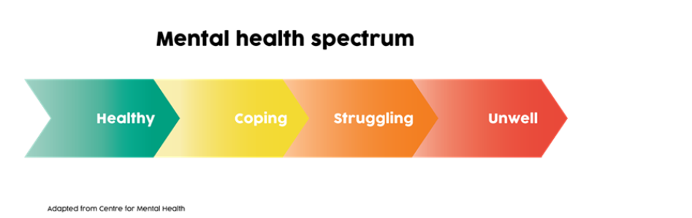
‘One in ten children and young people aged 5 to 16 has a clinically diagnosed mental health disorder and around one in seven has less severe problems.’ DfE, 2016.
Notes:
How we think about children’s mental health shapes how we work with children. Our own experiences, assumptions and knowledge may lead us to see ‘mental health’ as a specialist field that is the province of psychologists and psychiatrists and nothing to do with teaching. Alternatively, we may think of mental health in terms of a continuum which all of us are part of and which we move backwards and forwards across at different points in our lives. In this view children’s mental health is not a specialist field, but the concern of everyone in contact with children and central to the role of schools.
DfE (March 2016.)Mental health and behaviour in schools https://assets.publishing.service.gov.uk/government/uploads/system/uploads/attachment_data/file/508847/Mental_Health_and_Behaviour_-_advice_for_Schools_160316.pdf

Slide 16

Create a character…
Hobbies and interests
Health
Significant adults
Family
Friends
School
Personality
Environment
Notes:
In groups create a character on paper, give the child a name, age, gender and add details for each area.
We will meet this pupil again after considering risk factors that may affect their EHWB, considering what protective factors may impact and how as a school we can put support in place.

Slide 17
Risk Factors
‘Certain individuals and groups are more at risk of developing mental health problems than others. These risks can relate to the child themselves, to their family, or to their community or life events.’
‘Be mindful some groups of children are more vulnerable….these include but are not limited to, looked after children, children with learning difficulties, children on the autism spectrum and children from disadvantaged backgrounds.’
DfE March 2016.
Notes:
Risk factors are cumulative. Children exposed to multiple risks such as social disadvantage, family adversity and cognitive or attention problems are much more likely to develop behavioural problems.
Longitudinal analysis of data for 16,000 children suggested that boys with five or more risk factors were almost eleven times more likely to develop conduct disorder under the age of ten than boys with no risk factors.
Girls of a similar age with five or more risk factors were nineteen times more likely to develop the disorder than those with no risk factors.
More information about Risk or predisposing factors can be found here:
Mental health and behaviour in schools DfE March 2016. https://assets.publishing.service.gov.uk/government/uploads/system/uploads/attachment_data/file/508847/Mental_Health_and_Behaviour_-_advice_for_Schools_160316.pdf
Kids matterhttps://www.kidsmatter.edu.au/mental-health-matters/mental-health-basics-promoting-mental-health/risk-and-protective-factor
Mind matters: https://www.mindmatters.edu.au/docs/default-source/learning-module-documents/j4633_mm_module1-3-protectiveriskfactors_v2.pdf
Heads together: https://www.mentallyhealthyschools.org.uk/risks-and-protective-factors/

Slide 18
Predisposing Factors - Child
Genetic Influences
Low IQ and learning Disability
Specific development delay
Communication difficulty
Difficult temperament
Physical illness
Academic failure
Low self-esteem
Notes:
This information is taken from YMHFA handbook (all YMHFAiders are given on 2 day course) and DfE Mental health and behaviour in schools, both of which have tables detailing risk and protective factors for child and adolescent mental health.)

Slide 19

Predisposing Factors - Family
Overt parental conflict
Family breakdown
Inconsistent or unclear discipline
Hostile and rejecting relationships
Failure to adapt to children’s changing developmental needs
Abuse – physical, sexual, neglect and/or emotional
Parental psychiatric illness
Parental criminality, alcoholism, drug abuse and personality disorder
Death and loss – including loss of friendships

Slide 20
Predisposing Factors – Environment or community
Socio-economic disadvantage
Homelessness
Disaster, accidents, war and other overwhelming events
Discrimination
Other significant life events

Slide 21
What happens next?
The character you have created has started struggling to concentrate at your school for any length of time and has become inattentive. Parents have made the same observations.
What might be going on for your character?
How would you support them?
It’s all my fault. No-one can help me. I don’t want to go to school.

Slide 22
Depression
Home
School
Complaints of tiredness even if sleeping more
Difficulty doing chores
Withdrawal from family
Anger, anti-social behaviour
Avoid discussing future events
Insomnia, hypersomnia
Decline in grades
Absences/lateness
Less engaged, struggling to communicate/understand
Work less effectively in the morning
Irritable/avoid contact with peers
Risk taking behaviour
10%-17% likely to exhibit ‘behaviour problems.’
Notes:
DfE ‘Mental health and behaviour in schools’ March 2016 provides more information about mental health difficulties affecting young people and evidence-based support.
Includes attachment& hyperkinetic disorders e.g. ADHD
Online support
Depression Alliance: www.depressionalliance.org/information/what-depression
Books
Christopher Dowrick and Susan Martin (2015) Can I Tell you about Depression?: A guide for friends, family and professionals. London: Jessica Kingsley Publishers

Slide 23
Anxiety
Home
School
Tearful/not wanting to go to school
More time doing school work
Headaches/other physical symptoms
Demand constant reassurance
Irritable
Worrying about appearance/behaviour
Well behaved, quiet, fearful of asking questions
Demand constant reassurance
Fail to hand work in on time
Complain of physical illnesses at key times
Spending time alone
Visibly anxious
Notes:
Online support
Anxiety UK: www.anxietyuk.org.uk
Books
Lucy Willetts and Polly Waite (2014) Can I Tell you about Anxiety?: A guide for friends, family and professionals. London: Jessica Kingsley Publishers
Carol Fitzpatrick (2015) A Short Introduction to Helping Young People Manage Anxiety. London: Jessica Kingsley Publishers

Slide 24
Self harm
Self-harm describes any behaviour where a person causes harm to themselves in order to cope with thoughts, feelings or experiences they are not able to manage in any other way. It most frequently takes the form of cutting, burning or non-lethal overdoses in adolescents, while younger children and young people with special needs are more likely to pick or scratch at wounds, pull out their hair or bang or bruise themselves.
‘Self-harm’ is a behaviour and not an illness. People self-harm to cope with emotional distress or to communicate that they are distressed.’
MHFA
‘Between 1 in every 12 and 1 in 15 children and young people deliberately self-harm.’
Different things work for different people at different times; there are a wide range of ideas here to try. It’s always worth having follow up conversations with the young person you’re working with to find out what’s worked and what hasn’t so they can refine their list and determine the best strategies to employ at the moment they’re overcome with the need to harm.’
Pooky Knightsmith, Child and Adolescent Mental Health Specialist.
Notes:
At the moment when a young person is overcome by an urge or need to self-harm, it can be very helpful for them to have a range of different strategies they can tap into to try and cope with the way they are feeling right now without actually inflicting harm on themselves. Pooky knightsmith resources have in excess of 100 ideas which a young person could use as an alternative to self-harm.
Online support
SelfHarm.co.uk: www.selfharm.co.uk
National Self-Harm Network: www.nshn.co.uk
Books
Pooky Knightsmith (2015) Self-Harm and Eating Disorders in Schools: A Guide to Whole School Support and Practical Strategies. London: Jessica Kingsley Publishers
Keith Hawton and Karen Rodham (2006) By Their Own Young Hand: Deliberate Self-harm and Suicidal Ideas in Adolescents. London: Jessica Kingsley Publishers
Carol Fitzpatrick (2012) A Short Introduction to Understanding and Supporting Children and Young People Who Self-Harm. London: Jessica Kingsley Publishers

Slide 25
Eating disorders
Food, weight and shape may be used as a way of coping with, or communicating about, difficult thoughts, feelings and behaviours that a young person experiences day to day.
Some young people develop eating disorders such as anorexia , binge eating disorder and bulimia nervosa.
Particularly primary or preschool age, may develop problematic behaviours around food including refusing to eat in certain situations or with certain people. This can be a way of communicating messages the child does not have the words to convey. Look out for:
Very specific dietary rules
Rigidly sticking to their rules
Not deviating e.g. birthday cake
Disproportionately upset if their diet slips
Changing diet-vegetarian, no wheat, no pudding rule
Other control methods like heavy exercise or use of laxatives
Avoids eating in unfamiliar places
Becomes more unsociable
Sticks to familiar foods
Obsessing over insignificant weight gain
Judging themselves by their weight
Getting very angry over diet deviations
Describing themselves negatively using ‘fat talk.’
Notes:
http://www.inourhands.com/contact/
Pooky Knightsmith’s website, training and books provide thorough and useful information about eating disorders and self-harm
Online support
Beat – the eating disorders charity: www.b-eat.co.uk/about-eating-disorders
Eating Difficulties in Younger Children and when to worry: www.inourhands.com/eating-difficulties-in-younger-children
Books
Bryan Lask and Lucy Watson (2014) Can I tell you about Eating Disorders?: A Guide for Friends, Family and Professionals. London: Jessica Kingsley Publishers
Pooky Knightsmith (2015) Self-Harm and Eating Disorders in Schools: A Guide to Whole School Support and Practical Strategies. London: Jessica Kingsley Publishers
Pooky Knightsmith (2012) Eating Disorders Pocketbook. Teachers’ Pocketbooks

Slide 26
Suicide
Desperation, anger, guilt, worthlessness, loneliness, sadness, hopelessness, helplessness
Everything I do is wrong.
Everyone will be better off without me
Idea
Suicide
Developing a plan
Non-fatal suicidal behaviour
Lack of interest in appearance
Disturbed sleep
Change/loss of appetite/weight
Physical health complaints
Withdrawal, abuse of alcohol/drugs, self-harming, reckless behaviour, giving possessions away, secrecy
Notes:
MHFA book has specific information about responding to threat of suicide detailing specific questions to ask.
(we have followed this with pupils at Forest oak and recorded responses. If then a crisis CAMHS referral is made it is valuable information to pass on.)
Online support
Prevention of young suicide UK – PAPYRUS: www.papyrus-uk.org
On the edge: ChildLine spotlight report on suicide: www.nspcc.org.uk/preventing-abuse/research-and-resources/on-the-edge-childline-spotlight/
Books
Keith Hawton and Karen Rodham (2006) By Their Own Young Hand: Deliberate Self-harm and Suicidal Ideas in Adolescents. London: Jessica Kingsley Publishers
Terri A.Erbacher, Jonathan B. Singer and Scott Poland (2015) Suicide in Schools: A Practitioner’s Guide to Multi-level Prevention, Assessment, Intervention, and Postvention. New York: Routledge

Slide 27
Psychosis
Concerning signs | Early warning signs | Symptoms of psychosis
Tension Suspiciousness Depression Anxiety Irritability Anger Mood swings Sleep disturbances Appetite changes Memory and concentration problems Withdrawal | Emerging unusual beliefs Suspicion, mistrust perception that the world outside, self or others have changed or are acting different Belief that thoughts are speeded up or slowed down Loss of energy or motivation | Delusions Thought disorders Hallucinations

Slide 28
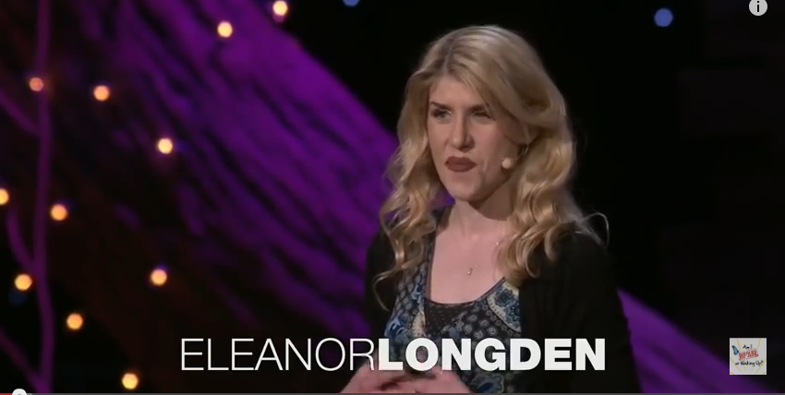
Notes:
You may want to show this entirety or just part. Illustrates what psychosis can feel like through one person sharing experience.

Slide 29
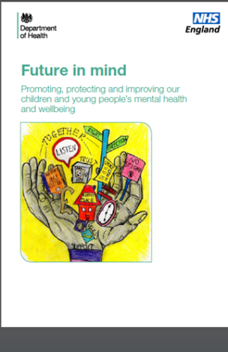
Future in Mind
‘The prevalence of mental health problems in children and adolescents was last surveyed in 2004. This study estimated that:
9.6% or nearly 850,000 children and young people aged between 5-16 years have a mental disorder
7.7% or nearly 340,000 children aged 5-10 years have a mental disorder
11.5% or about 510,000 young people aged between 11-16 years have a mental disorder
This means in an average class of 30 schoolchildren, 3 will suffer from a diagnosable mental health disorder
3.2The most common diagnostic categories were conduct disorders, anxiety, depression and hyperkinetic disorders.’
there were 1 in 8 children aged 10 to 15 who reported symptoms of mental ill-health in 2011 to 2012, as measured by a high or very high total difficulties score
Notes:
https://assets.publishing.service.gov.uk/government/uploads/system/uploads/attachment_data/file/414024/Childrens_Mental_Health.pdf2015
https://assets.publishing.service.gov.uk/government/uploads/system/uploads/attachment_data/file/454495/Childrens_Mental_Health_EasyRead.pdf
(Mental Health Difficulties in Early Adolescence: A Comparison of Two Cross-Sectional Studies in England From 2009 to 2014)
•We examined changes in adolescents' mental health problems between 2009 and 2014.
•Most aspects of mental health problems remained stable in this period.
•Total difficulties in boys decreased across the 5 years.
•Girls had significantly greater emotional problems in 2014 than 2009.

Slide 30
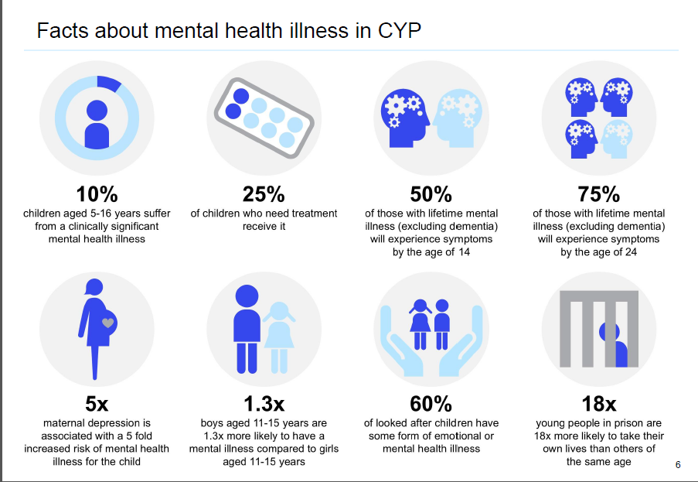
Notes:
https://assets.publishing.service.gov.uk/government/uploads/system/uploads/attachment_data/file/575632/Mental_health_of_children_in_England.pdf

Slide 31
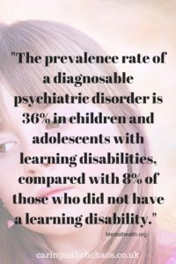
Links with SEND
mentalhealth.org part of mental Health Foundation says
‘One in four people experience difficulties with mental health in any one year.
Between 25 and 40% of people with learning disabilities also experience from mental health problems.
For children and young people, the prevalence rate of a diagnosable psychiatric disorder is 36% in children and adolescents with learning disabilities, compared with 8% of those who did not have a learning disability.
These young people were also 33 times more likely to be on the autistic spectrum and were much more likely than others to have emotional and conduct disorders’
Notes:
https://www.mentalhealth.org.uk/learning-disabilities/help-information/learning-disability-statistics-/187699

Slide 32
Treatment
Waits for treatment can vary considerably in different areas, with the shortest around four weeks and the longest in one provider with waits of up to 100 weeks from referral to treatment. Latest data shows that in 2016/17 the average wait for treatment in a CYPMHS was 12 weeks.
170,000 children in England prescribed drugs to treat depression & anxiety between April 2015 and June 2016, an increase of 12% since previous year. (Guardian, June 2017.)

Slide 33

ALGEE YMHFA approach
Ask, Assess, Act
Listen non-judgementally
Give reassurance and information
Enable the young person to get appropriate professional help
Encourage self-help strategies
Notes:
Discuss if we were having EHWB difficulties who would you approach? A partner? friend? Family member? Colleague? What would you want that person to do? How would it affect you if person appeared shocked? Horrified? Scared? Indifferent? Un-interested?
How important is the ‘listen non-judgementally’ aspect of this? Would you approach someone who did not actively listen? Who attempted to ‘solve’ your problems? Or who shared worse problems or dismissed easily?
How can we be better listeners for our pupils and each other? Do we feel confident using this process? Who would we go to to support pupil with accessing professional help? Do we know of self-help strategies we could encourage?

Slide 34
In our school… discussion…
Notes:
Identify YMHFAs in your school.
Discuss is this something we can all do or just mental health professionals and/or YMHFA?
How do you utilise this support in your school?
Make links with CP and DLS in terms of disclosures and confidentiality. Stress any relevant aspects of own school policy.
How do you make pupils aware of importance of talking to someone and who/where they can access help?
Talking to students when they make mental health disclosures
The advice below is from students themselves, in their own words, together with some additional ideas to help you in initial conversations with students when they disclose mental health concerns. This advice should be considered alongside relevant school policies on pastoral care and child protection and discussed with relevant colleagues as appropriate.
Focus on listening
“She listened, and I mean REALLY listened. She didn’t interrupt me or ask me to explain myself or anything, she just let me talk and talk and talk. I had been unsure about talking to anyone but I knew quite quickly that I’d chosen the right person to talk to and that it would be a turning point.”
If a student has come to you, it’s because they trust you and feel a need to share their difficulties with someone. Let them talk. Ask occasional open questions if you need to in order to encourage them to keep exploring their feelings and opening up to you. Just letting them pour out what they’re thinking will make a huge difference and marks a huge first step in recovery. Up until now they may not have admitted even to themselves that there is a problem.
Don’t talk too much
“Sometimes it’s hard to explain what’s going on in my head – it doesn’t make a lot of sense and I’ve kind of gotten used to keeping myself to myself. But just ‘cos I’m struggling to find the right words doesn’t mean you should help me. Just keep quiet, I’ll get there in the end.”
The student should be talking at least three quarters of the time. If that’s not the case then you need to redress the balance. You are here to listen, not to talk. Sometimes the conversation may lapse into silence. Try not to give in to the urge to fill the gap, but rather wait until the student does so. This can often lead to them exploring their feelings more deeply. Of course, you should interject occasionally, perhaps with questions to the student to explore certain topics they’ve touched on more deeply, or to show that you understand and are supportive. Don’t feel an urge to over-analyse the situation or try to offer answers. This all comes later. For now your role is simply one of supportive listener. So make sure you’re listening!
Don’t pretend to understand
“I think that all teachers got taught on some course somewhere to say ‘I understand how that must feel’ the moment you open up. YOU DON’T – don’t even pretend to, it’s not helpful, it’s insulting.”
The concept of a mental health difficulty such as an eating disorder or obsessive compulsive disorder (OCD) can seem completely alien if you’ve never experienced these difficulties first hand. You may find yourself wondering why on earth someone would do these things to themselves, but don’t explore those feelings with the sufferer. Instead listen hard to what they’re saying and encourage them to talk and you’ll slowly start to understand what steps they might be ready to take in order to start making some changes.
Don’t be afraid to make eye contact
“She was so disgusted by what I told her that she couldn’t bear to look at me.”
It’s important to try to maintain a natural level of eye contact (even if you have to think very hard about doing so and it doesn’t feel natural to you at all). If you make too much eye contact, the student may interpret this as you staring at them. They may think that you are horrified about what they are saying or think they are a ‘freak’. On the other hand, if you don’t make eye contact at all then a student may interpret this as you being disgusted by them – to the extent that you can’t bring yourself to look at them. Making an effort to maintain natural eye contact will convey a very positive message to the student.
Offer support
“I was worried how she’d react, but my Mum just listened then said ‘How can I support you?’ – no one had asked me that before and it made me realise that she cared. Between us we thought of some really practical things she could do to help me stop self-harming.”
Never leave this kind of conversation without agreeing next steps. These will be informed by your conversations with appropriate colleagues and the schools’ policies on such issues. Whatever happens, you should have some form of next steps to carry out after the conversation because this will help the student to realise that you’re working with them to move things forward.
Acknowledge how hard it is to discuss these issues
“Talking about my bingeing for the first time was the hardest thing I ever did. When I was done talking, my teacher looked me in the eye and said ‘That must have been really tough’ – he was right, it was, but it meant so much that he realised what a big deal it was for me.”
It can take a young person weeks or even months to admit they have a problem to themselves, let alone share that with anyone else. If a student chooses to confide in you, you should feel proud and privileged that they have such a high level of trust in you. Acknowledging both how brave they have been, and how glad you are they chose to speak to you, conveys positive messages of support to the student.
Don’t assume that an apparently negative response is actually a negative response
“The anorexic voice in my head was telling me to push help away so I was saying no. But there was a tiny part of me that wanted to get better. I just couldn’t say it out loud or else I’d have to punish myself.”
Despite the fact that a student has confided in you, and may even have expressed a desire to get on top of their illness, that doesn’t mean they’ll readily accept help. The illness may ensure they resist any form of help for as long as they possibly can. Don’t be offended or upset if your offers of help are met with anger, indifference or insolence, it’s the illness talking, not the student.
Never break your promises
“Whatever you say you’ll do you have to do or else the trust we’ve built in you will be smashed to smithereens. And never lie. Just be honest. If you’re going to tell someone just be upfront about it, we can handle that, what we can’t handle is having our trust broken.”
Above all else, a student wants to know they can trust you. That means if they want you to keep their issues confidential and you can’t then you must be honest. Explain that, whilst you can’t keep it a secret, you can ensure that it is handled within the school’s policy of confidentiality and that only those who need to know about it in order to help will know about the situation. You can also be honest about the fact you don’t have all the answers or aren’t exactly sure what will happen next. Consider yourself the student’s ally rather than their saviour and think about which next steps you can take together, always ensuring you follow relevant policies and consult appropriate colleagues.

Slide 35
Session 2
Hoped for outcomes
Consider risk factors alongside protective factors in developing resilience and response to stress
Consider stresses individual children in our classes have.
Identify protective factors
Understand some behaviours or coping strategies; unhelpful and helpful.
Plan our smile introduction and/or some activities for our school using 5 SMILE ways to well being and helpful coping strategies.

Slide 36
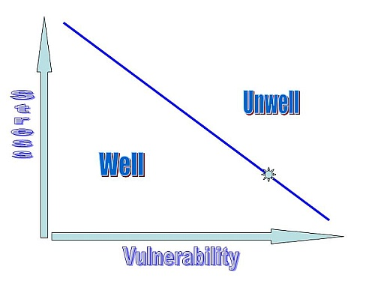
a
b
c
Notes:
Zubin, J and Spring, B Stress vulnerability model, (1977.)
Each individual has unique biological, psychological and social elements, these include strengths and vulnerabilities for dealing with stress.
Person a has very low vulnerability and so can withstand a huge amount of stress before becoming ill.
Person b has a higher vulnerability perhaps due to genetic predisposition.
Person c also could have this genetic loading but also suffered trauma at young age so person a and b can take more stress before becoming ill.

Slide 37
Protective Factors
some children exposed to significant risk factors develop into competent, confident and caring adults.
In promoting children’s mental health we need an understanding of the protective factors that enable children to be resilient when they encounter problems and challenges.
As social disadvantage and the number of stressful life events accumulate for children or young people, protective factors are needed to counterbalance.

Slide 38
A School’s role
‘School should be a safe and affirming place for children where they can develop a sense of belonging and feel able to trust and talk openly with adults about their problems.’
DfE lists risk and protective factors within school as below
Risk
Protective
Bullying
Discrimination
Breakdown in or lack of positive friendships
Deviant peer influences
Peer pressure
Poor pupil to teacher relationships
Clear policies on behaviour and bullying
‘Open door’ policy for children to raise problems
A whole-school approach to promoting good mental health
Positive classroom management
A sense of belonging
Positive peer influences
Notes:
https://assets.publishing.service.gov.uk/government/uploads/system/uploads/attachment_data/file/508847/Mental_Health_and_Behaviour_-_advice_for_Schools_160316.pdf

Slide 39
Child characteristics
risks
protective
Low birth weight, birth injury
Learning difficulty, low IQ
Academic failure, exclusion
Disability, delayed development
Long term illness
Early behavioural difficulties
Poor social skills
Poor attachment
Substance use
Experience of violence and abuse
Bullying and peer rejection
Social skills
Balanced easy temperament
No less than average intelligence
Attachment to family
Independence
Good problem solving skills
Capacity to reflect
Experiences success or achievement
Notes:
Highlighted in green are ones we can support pupils to develop, there may be others….

Slide 40
Community and social factors
risk
protective
Socioeconomic disadvantage
Unemployment
Poor housing conditions and access to open spaces
Poor education
Poor health care provision
Isolation
Poor neighbourliness
Discrimination
Bullying
Personal safety
Positive social networks; peers, teachers, neighbours
Access to positive opportunities, e.g. education
Good housing
High standard of living
Participation in community activities
Range of sport and leisure activities
Notes:
How likely are our children likely to develop mental health illness at some point after considering these risk factors. How much stress are they likely to be able to cope with before becoming ill?

Slide 41
Parents and parenting style
risk
protective
Single parent
Young maternal age
Parental mental health problems
Drug and alcohol abuse
Harsh or inconsistent discipline
Lack of stimulation of child
Lack of warmth and affection
Rejection of child
Abuse or neglect
Competent, stable care
Breast feeding
Positive attention and affection from parents
Supportive relationship with adults
Faith or spirituality
Clear consistent discipline

Slide 42
Family factors and life events
risk
protective
Family instability, conflict or violence
Marital disharmony or divorce
Poor intergenerational contact
Large family size, rapid births
Absence of father
Very low level of parental education
Unsupported bereavement
Young carer
Genetic make up
Family harmony
Positive relationships with extended family
Small family size
Spacing of siblings by more than 2 years

Slide 43
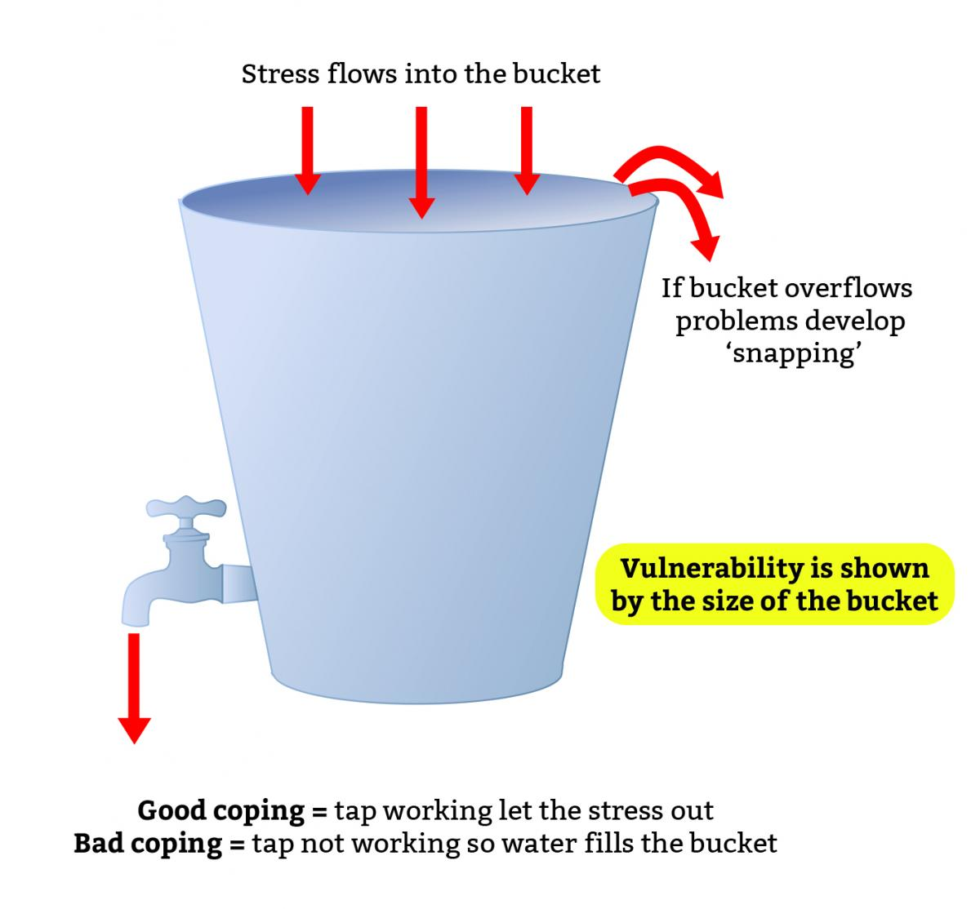
Add a bit more stress….?!
https://www.foryoubyyou.org.uk/stress-bucket
Notes:
All of us have stress, consider one young person in your class and add to the bucket all the stress they might be experience right now.
If they don’t have some of the protective factors discussed, bucket will overflow- this will show in negative , challenging, unhelpful behaviours.
What can we do? Teach coping skills
Downloadable stress bucket sheet, used with staff and adapted for pupils can be found here.
https://www.foryoubyyou.org.uk/stress-bucket

Slide 44
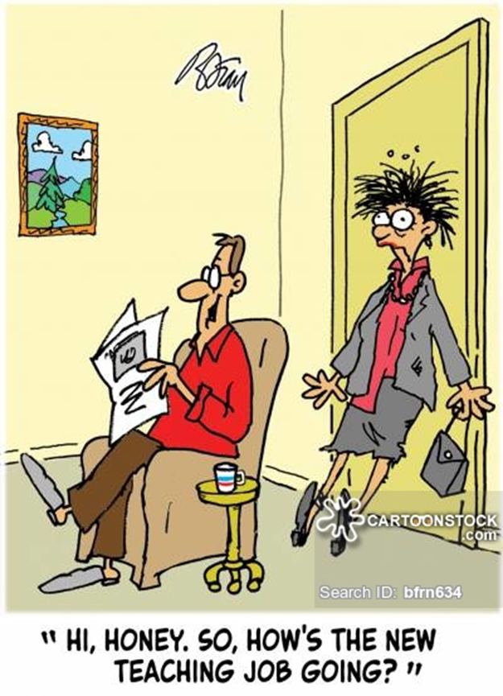
Staff MHWB?....
8/10 people working in education experienced at least one mental health condition in past 2 years & only 18% used a wellbeing support service (Education Support Partnership, 2016)
3,750 teachers signed off on long-term sick leave due to pressure, anxiety & mental illness. (Independent, January 2018.)
Teachers seeking mental health support has risen by 35% in past 12 months (Guardian, April 2018.)
52% of 775 teachers in survey by Leeds Beckett University reported poor mental health, diagnosed by GP, (2018.)
68% of teachers surveyed by NASUWT reported their role prevented them giving adequate time to partners, family & friends. (Julian Stanley, SecEd, May 2017.)
Notes:
Teacher work load, a reported crisis in recruitment and pay (Independent suggests that pay was 12% less in 2015 than 2005,) combined with the nature of the job whichh timetables hour by hour and which has high accountability and demands from numerous stakeholders….
More info about staff wellbeing available here:
https://www.annafreud.org/media/7653/3rdanna-freud-booklet-staff-wellbeing-web-pdf-21-june.pdf

Slide 45
Helpful 0r Unhelpful Coping strategies
Do we ever use these to cope?
Yell at someone
Not eat for long periods
Drink excessive amounts of alcohol
Drink lots of coffee or coke
Smoke tobacco
Take part in a Recreational activity
Kick something
Drive fast
Think this is not forever, some things I cannot change
Bite fingernails
Socialise with friends
Scratch or cut self
Engage in creative activity
Risky relationships and situations
Opt out or give up
Work on puzzles or games
Read
Talk to people
Withdraw from family or friends
Listen to music
Swear
Go to cinema
Act violently e.g. punch wall
Meditate and engage in relaxation
Stretch
Overeat
Exercise
Spend time outside or in garden
Criticise , gossip, bully or tease others
Throw something
Watch television
Go for a walk
Take drugs
Go to gym or swimming
Steam room or sauna
Procrastinate
Create a plan and prioritise work
Pace up and down
Engage in hobby e.g. Sing, Cook
Write down thoughts and feelings
Pull hair
Cry
Scream
Take tranquilisers
Consider which are helpful
Notes:
Refer to the stress bucket-coping skills are like the tap..bad coping skills will stop stress run out.
We can look at some ‘behaviours’ as coping strategies and teach helpful alternative coping strategies.
Identify helpful and un-helpful in a group and then discuss.
This could be an activity to look at for ourselves. It can lead to positive and honest discussions about some unhealthy practices we may have and also consider when does something which helps us to cope become an unhealthy habit not only to us but within a community.

Slide 46
NHS Five ways to wellbeing
Notes:
In 2008 the New economics Foundation, nef, was commissioned by the UK Government’s foresight Project on mental capital and wellbeing to review the work of over 400 scientists from across the world. The aim was to gather evidence on practical, accessible steps people could take to improve mental wellbeing.
Wellbeing (feeling good and functioning well) is important for everyone.
Developing habits for wellbeing is best done when you are feeling ok rather than waiting until things are difficult.
Taking these five actions regularly will help improve wellbeing.
Finding ways to include the Five Ways to Wellbeing actions as part of everyday routines is the best way to improve your wellbeing.
Ask the young person to focus on a time when they felt good. What were they doing, who were they with? You can then link this to one or more of the Five Ways to Wellbeing actions.
“Research has shown that people who feel happier – or who have good wellbeing – can
live for 7.5 years longer than someone who doesn’t.
The Five Ways to Wellbeing are a set of evidence-based actions which promote people’s wellbeing. They are: Connect, Be Active, Take Notice, Keep Learning and Give. These activities are simple things individuals can do in their everyday lives.
The Five Ways to Wellbeing were developed by nef from evidence gathered in the UK government’s Foresight Project on Mental Capital and Wellbeing. The Project, published in 2008, drew on state-of-the-art research about mental capital and mental wellbeing through life. It asked nef to develop the Five Ways to Wellbeing to communicate its key findings.
The Five Ways have been used by health organisations, schools and community projects across the UK and around the world to help people take action to improve their wellbeing. They’ve been used in lots of different ways, for example to get people to start thinking about wellbeing, to develop organisational strategy, to measure impact, to assess need, for staff development, and to help people to incorporate more wellbeing-promoting activities into their lives.
Young people with a good level of wellbeing are more likely to perform well at school and be
physically healthy (Department of Health, 2011).
• Enabling young people to develop awareness about the importance of looking after their wellbeing
could offer benefits for their mental health in the future because we know that 75% of adult mental
health problems begin before the age of 18 (CMO, 2012).
• Emotional and mental wellbeing could be a protective factor in reducing the likelihood of young
people using drugs or alcohol (Public Health England, 2013)
Make the most of opportunities and deal with stressful situations by taking time out and learning
how to cope when things get tough.
• Increase their interpersonal skills, empathy and communication skills through giving and seeing
themselves as part of the wider community.
• Increase their chances of employability and self-worth by taking notice of what they are good at
and what they have to offer others.

Slide 47

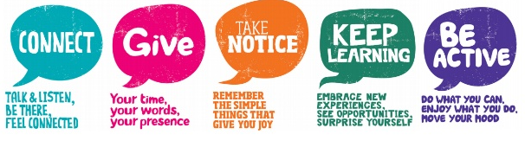
Connect – connect with the people around you: your family, friends, colleagues and neighbours. Spend time developing these relationships.
Be active – you don't have to go to the gym. Take a walk, go cycling or play a game of football. Find an activity that you enjoy and make it a part of your life.
Keep learning – learning new skills can give you a sense of achievement and a new confidence. So why not sign up for that cooking course, start learning to play a musical instrument, or figure out how to fix your bike?
Give to others – even the smallest act can count, whether it's a smile, a thank you or a kind word. Larger acts, such as volunteering at your local community centre, can improve your mental wellbeing and help you build new social networks.
Take notice – be more aware of the present moment, including your thoughts and feelings, your body and the world around you. Some people call this awareness "mindfulness". It can positively change the way you feel about life and how you approach challenges.
Notes:
https://www.nhs.uk/conditions/stress-anxiety-depression/improve-mental-wellbeing/
http://www.fivewaystowellbeing.org/
http://www.nhs.uk/Tools/Pages/Wellbeing-self-assessment.aspx
http://www.hertsdirect.org/docs/pdf/f/fivewaytoolkit.pdf
https://www.foryoubyyou.org.uk/our-services/wellbeing-and-mental-health/other-resources/five-ways-wellbeing

Slide 48
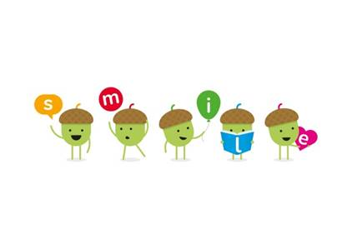
The SMILE Approach
Adapted from the NHS ‘Five Ways to Mental Wellbeing’
Connect
Be active
Take notice,
be mindful
Keep learning
Give to others
SMILE
est. Forest Oak School 2014
Socialise
Move
Interest
Learn
Engage
Notes:
We saw that these were practical, positive steps that we could use and teach to our pupils but we wanted to make the 5 ways memorable to staff and pupils.

Slide 49
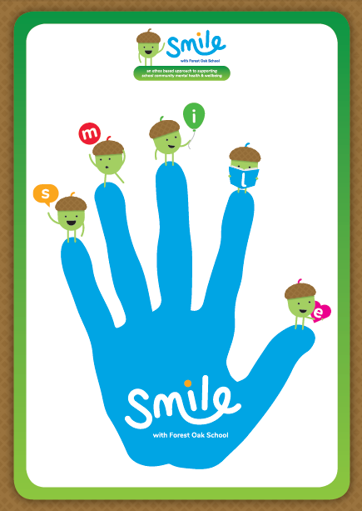
“Give me 5 to make me SMILE!”
Through this approach we can actively promote and teach positive coping skills to pupils
Notes:
The hand is used a familiar symbol, pupils and staff can count the acronym on the fingers and physically do high 5s?!
Pupils are used to the 5 a day approach to fruit & veg and can use as a broad measure to support healthy diet.

Slide 50



5 ways to wellbeing…what are they?
Notes:
Activity:
5 tables with an activity demonstrating one of each of the 5 ways to wellbeing/SMILE ways.
Staff move round in groups. Allow 5 minutes at each table.
Socialise-connect e.g. Use cards to get people talking…Talk to the person next to you about something you love/last TV programme you watched/best friend. Put some interesting/unusual facts to discuss. Write down some jokes to share….
Move-get active e.g. provide balls for Keepy uppies. Leave instructions for dances to practice e.g. floss etc
Interest-take notice e.g. mindful eating; leave instructions with malteasers / raisins
Learn-keep learning e.g. leave instructionsand resources for a new skill e.g. quick craft activity
Engage-give to others e.g. read some inspirational stories about others around the word, write kindness tokens to someone on table you appreciate..

Slide 51

Notes:
Organising staff into groups who they may not usually work with can help to bring to the sessions different ideas, wider discussion and enable further social connections amongst teams.

Slide 52
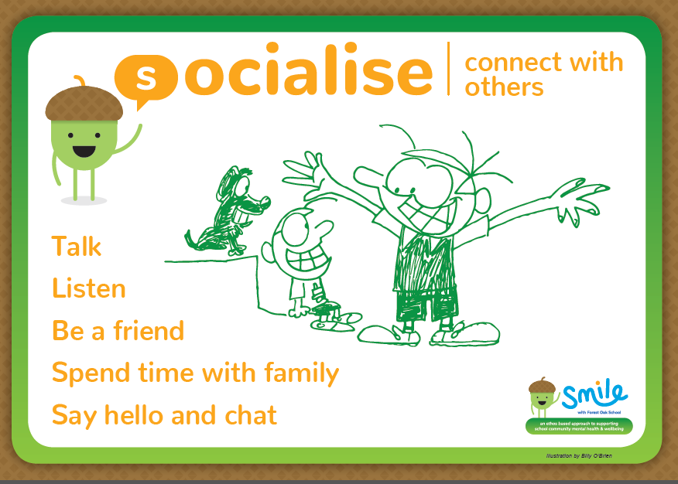
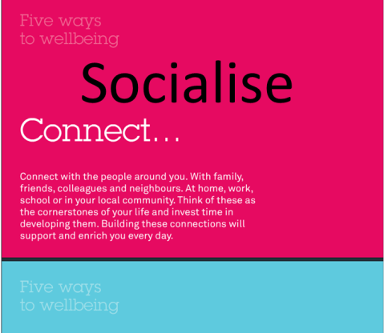
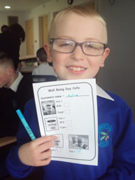
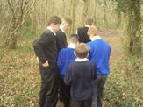
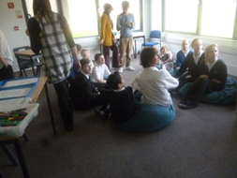

Slide 53
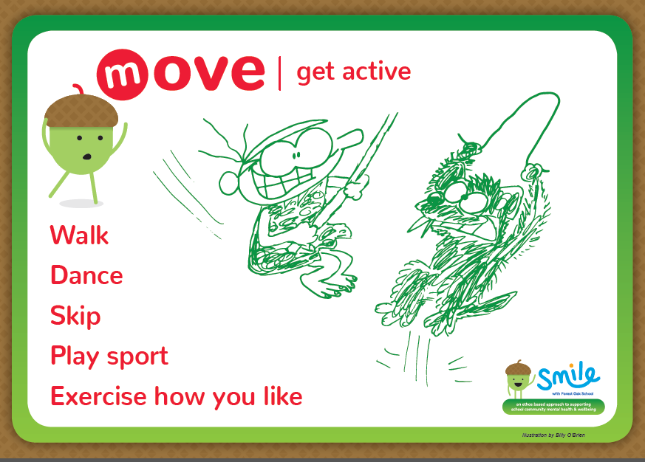
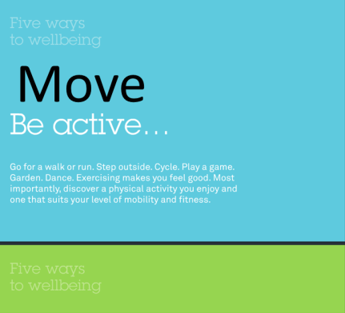
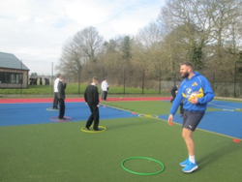
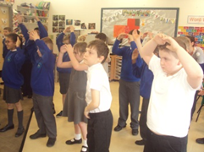
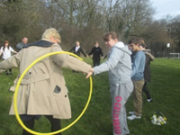
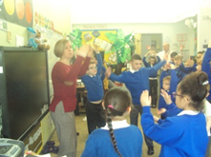

Slide 54
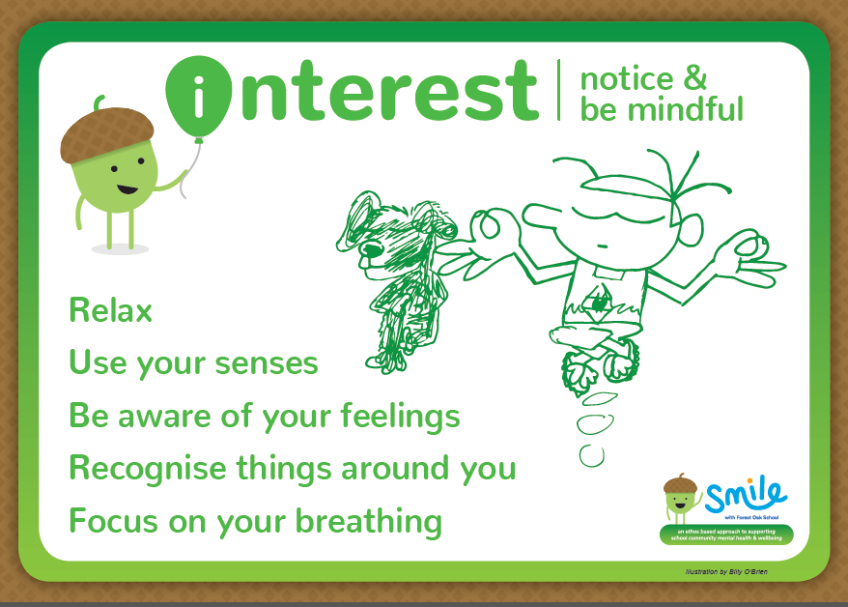

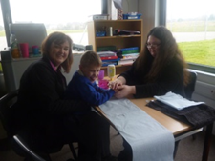
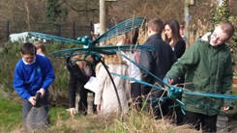
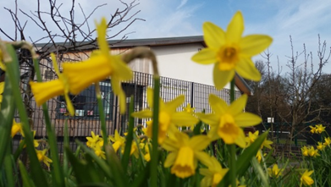

Slide 55
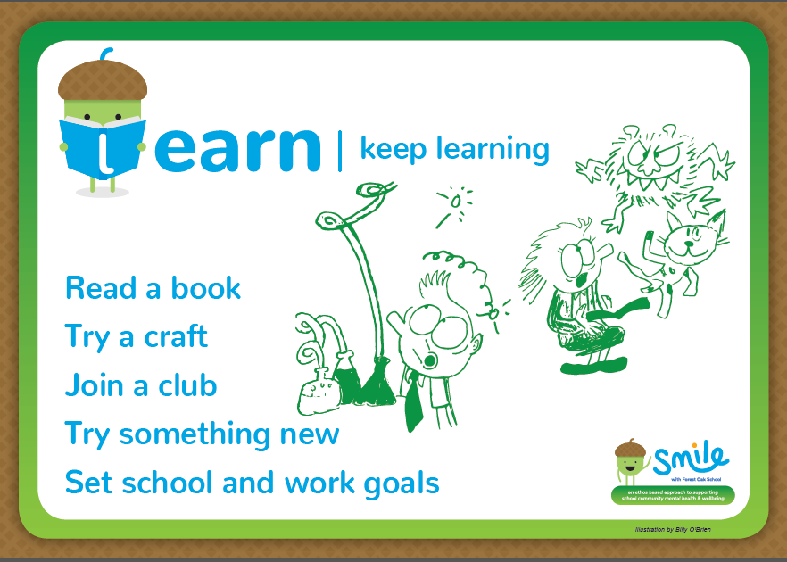
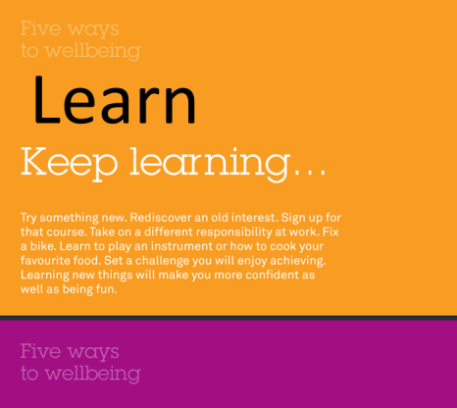
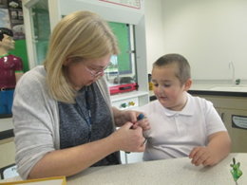
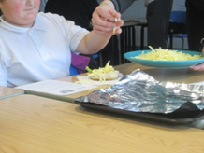

Slide 56
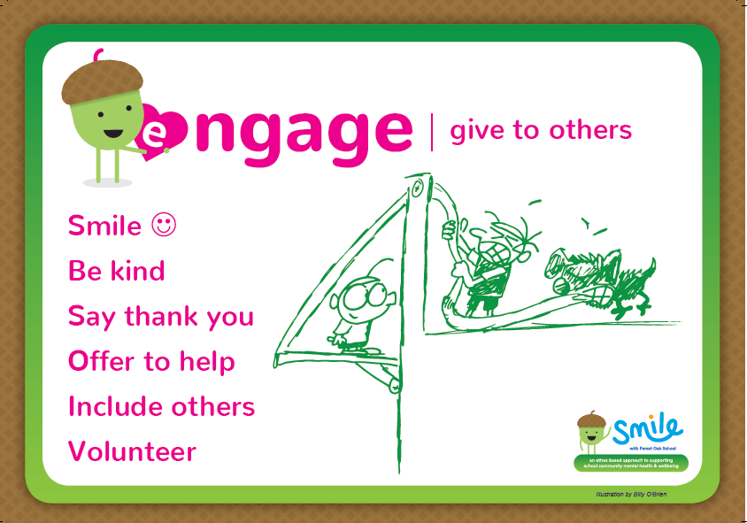
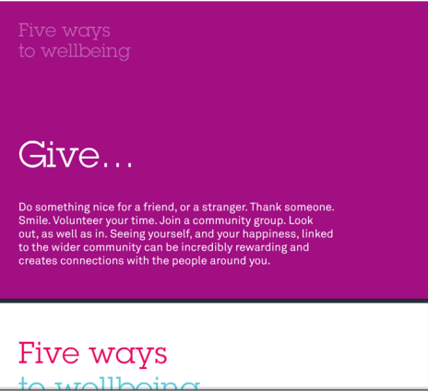
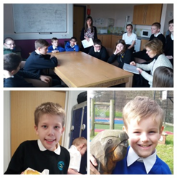
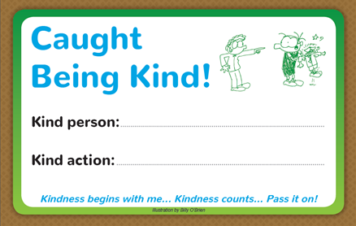
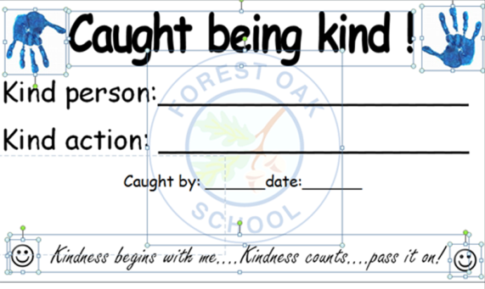
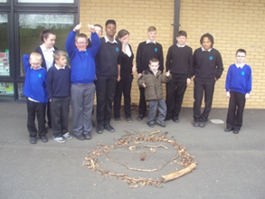

Slide 57
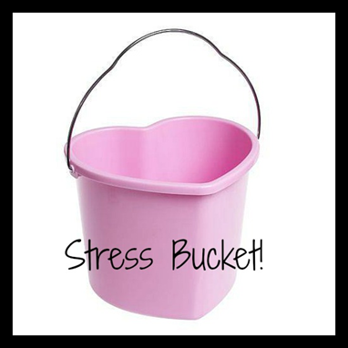
Wellbeing ‘Homework.’
Just Consider your own stress bucket at moment
Ask yourself the questions…
Do I have any evidence to support my feelings?
What can I change?
What can’t I change and need to accept?
What needs my urgent attention?
Can anyone help me?
Spend 30 minutes for yourself doing a ‘helpful coping strategy’ consider each of the SMILE steps to wellbeing for ideas…

Slide 58
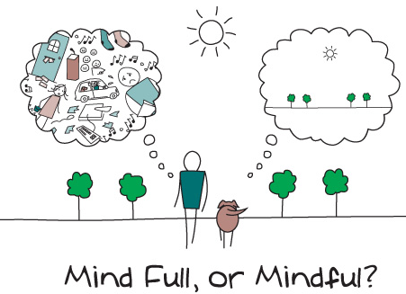

https://www.mind.org.uk/information-support/drugs-and-treatments/mindfulness/
Notes:
Link to mind website about mindfulness

Slide 59
Possible Session 3
Hoped for outcomes
Review SMILE resources & practices used at Forest Oak.
Explain EHWB whole school audit completed by SLT/EHWB lead and share any gaps identified.
Share agreed priority focus and best hoped- for outcomes for our school.
Explain pupil assessments and process/deadlines
Agree target group, class or area.
Audit (& celebrate) where our whole school already teaches and provides opportunities for SMILE steps
Notes:
This session could be done at a staff meeting- part of the individual school planning process for building in smile to your school

Slide 60
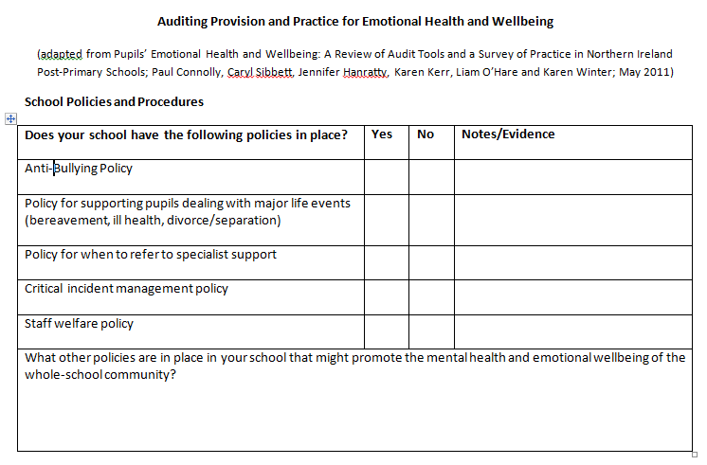

EHWB whole school audit & gap analysis
School policies and procedures
School practices
Pupil experience
Education/other staff experience
Established EHWB programmes
Adapted from:
Notes:
Share anything identified through completing your school’s audit. It may have identified gaps or supported what staff teams have already identified or working on. e.g. we have all this but is it recorded anywhere? Do all staff follow same process?

Slide 61

School Improvement Priorities, Planning and Aims
Socialise (connect)
e.g. play times
e.g. parent coffee mornings
e.g. targeted clubs and activities
e.g staff shared lunch
Move
(be active)
e.g.PE lessons
e.g.Physical clubs-rugby,football,dodgeball
e.g.playtime and lunchtime games and activities
e.g.Moving breaks (KS3/4)
Interest
(take notice, be mindful.)
Engage (give to others)
Learn
(keep learning)
Notes:
This allows schools to map the different interventions in each area for pupils, staff and families, and to review them periodically and see how close they are to being achieved (RAG rating)
Use example provided or just brainstorm around each area. Ensure all staff across school can input.
This may be done earlier to support identifying gaps and also later to review and evaluate.

Slide 62
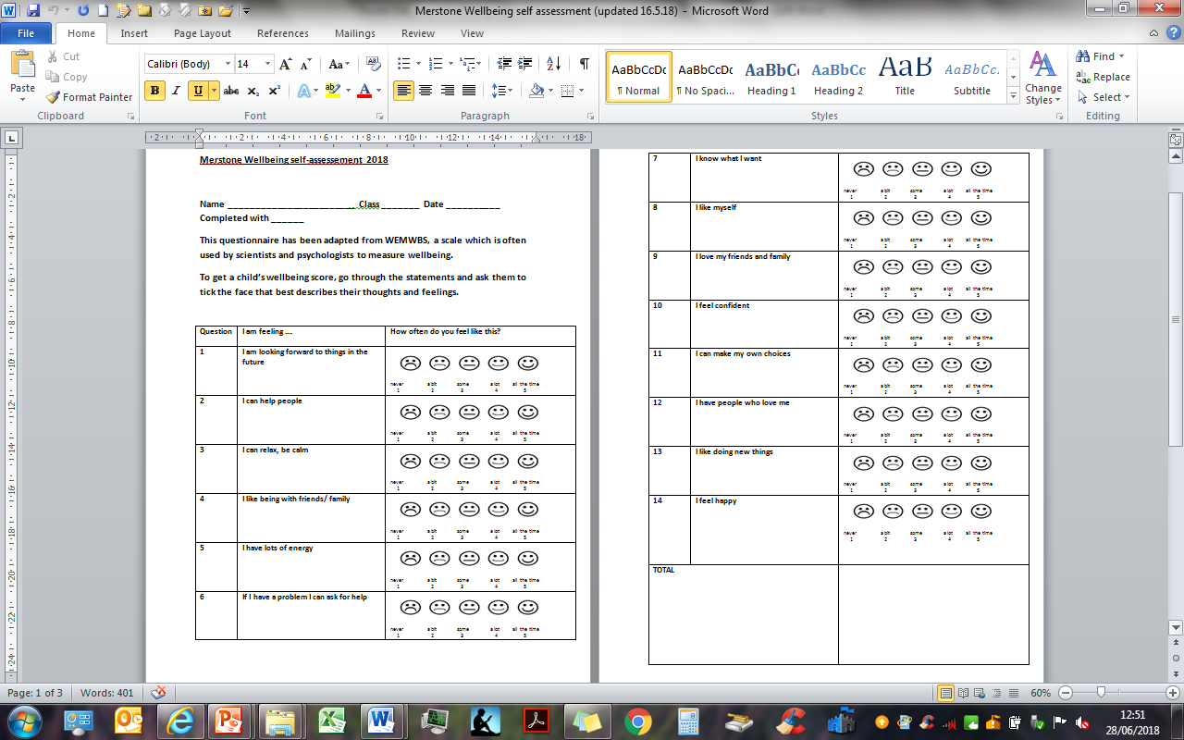
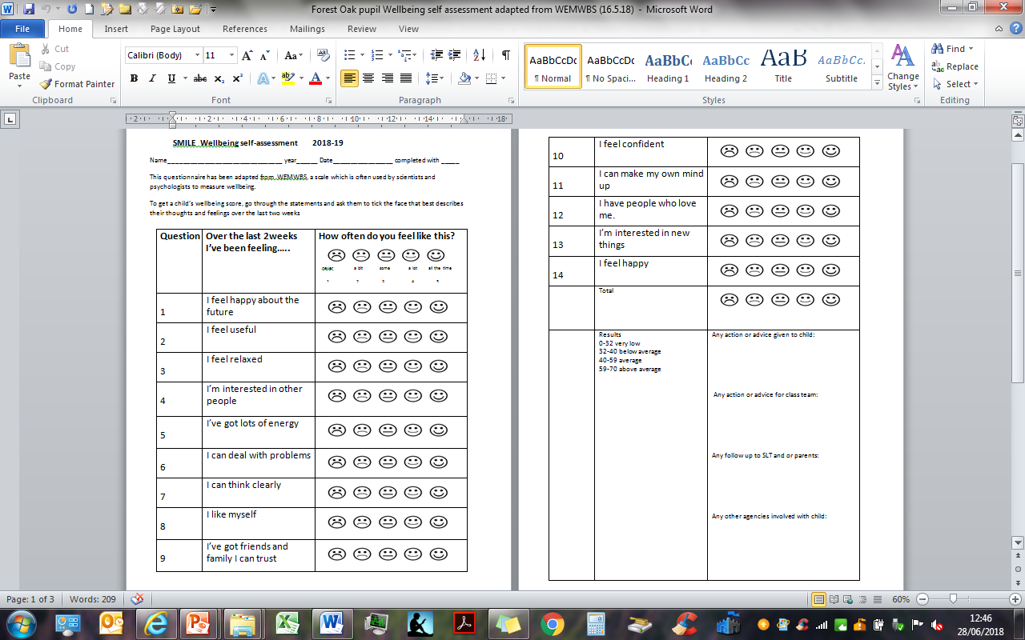
WEMWBS adapted for pupils
For pupils with MLD
For pupils with SLD
Notes:
Explanation of how to use with pupils: see instructions on top of forms.
Following discussion with partners we will also provide a version with a two-choice response?? Do we want to do this? Should pupils who can’t access SLD version use non-verbal version?
Schools have a choice of which version they use.
This will be discussed further on 19.9.18.

Slide 63
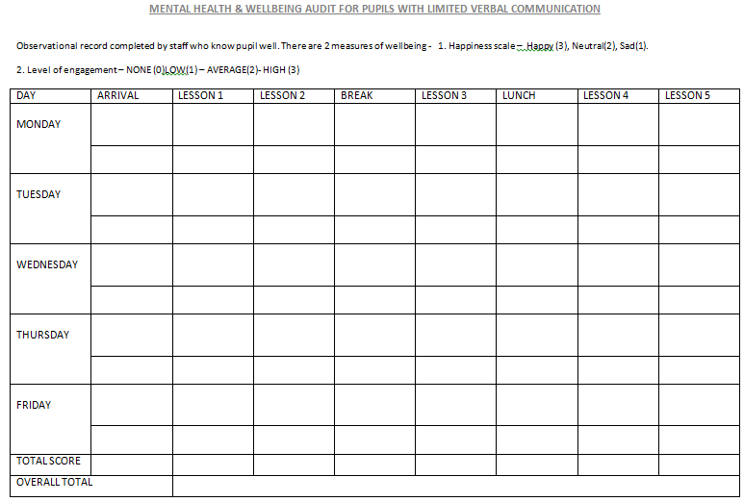
Mental Health and Wellbeing Audit for pupils with limited verbal communication
(observation)
Notes:
Amanda explain

Slide 64

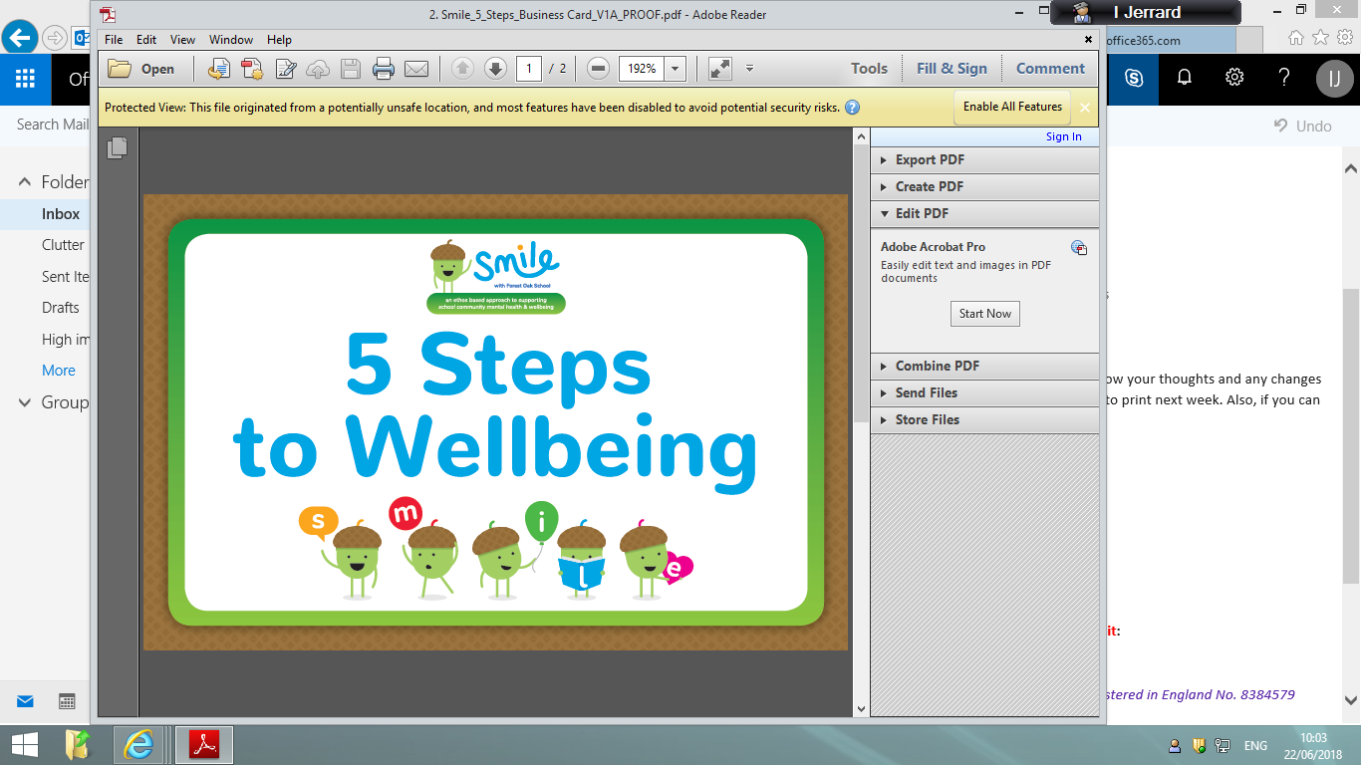
Introduce, teach and provide opportunities for …
How will you launch? e.g.
Wellbeing day or arts week
Assembly focus
Referring to visual resources provided
Clubs and activities
Notes:
How are we going to intro to pupils at our school?

Slide 65
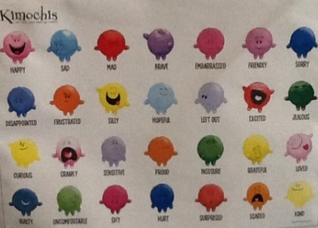
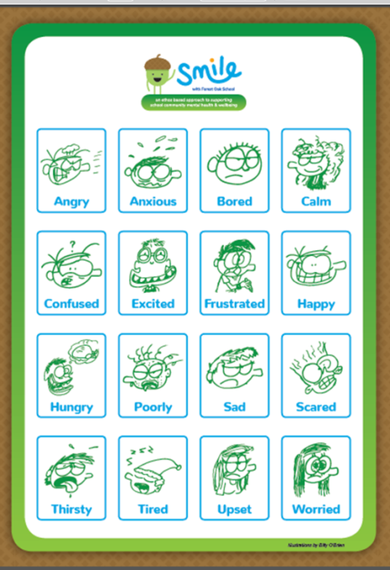
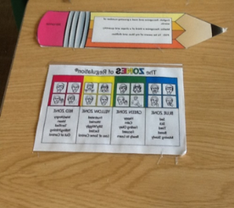
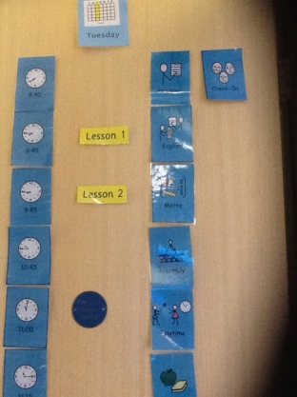
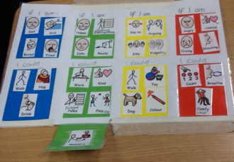








Check ins-
Daily ‘check ins’ promote listening and engaging with others. Taking an interest in feelings and developing emotional literacy supports coping skills and seeking help.
How are you feeling today?
What's happened?
What would help?
Notes:
Could you use daily check ins (resource poster is in each school’s pack but in any school there will be many ways to ask the question how are you feeling?)

Slide 66


Listening through
Restorative questions
Notes:
These questions can be used to link thoughts, feelings and behaviours. It enables all to be listened to and based on Restorative practice, aims to repair harm not punish or blame.

Slide 67




Using Individual Coping scales
Sometimes building resilience is just about ‘coping.’
Using a positive coping scale supports pupils to…
Recognise emotions in their bodies
Name and share what it feels and looks like
Think about what they could do to help self and asking for help
Have a shared, visual plan
Celebrating successes
Notes:
These can be used to talk to a child about their feelings, what helps and what triggers. At Forest Oak they are part of PHP or behaviour plans.
Each one would be personal to a pupil and would need staff working with them to identify names for feelings, behaviours, positive coping strategies etc.
Some pupils find it easier to point at a scale or shout a number than say how they are feeling. They may not be able to articulate feelings and what would help at that point.
They enable pupils to see that there is a progression to emotions, not just happy and sad or angry and that they can learn to recognise them and put strategies in place at different stages to manage more themselves or ask for help

Slide 68


Adopting a whole school kindness initiative?...
Notes:
All schools have reward systems, increasing the value of being kind to others for community and an individual supports pupil wellbeing
Kindness is easy & essential value to promote.
Resources below could be links to use:
https://www.youtube.com/watch?v=nwAYpLVyeFU
https://www.youtube.com/watch?v=uoiIYlww8M4Pig of happiness- Edward Monkton story
https://www.youtube.com/watch?v=rwelE8yyY0UColour your world with kindness-cartoon
https://www.youtube.com/watch?v=nwAYpLVyeFUKindness chain video-older pupils
https://www.youtube.com/watch?v=gVLc9M-qbpoRAK kindness-interflora advert-older
https://www.youtube.com/watch?v=1yLg1nPua0kKindness song (for younger pupils.)
Twinkl has lots of kindness resources

Slide 69

Other examples of Interventions or support
Pet therapy
CBT anxiety support
Anger or self-management support sessions
Heart math to support mindful breathing
Individual or group play, creative arts & music therapy
Rest & relax sessions- group meditation & massage
Daily exercise sessions, e.g. daily mile
Class mindfulness or yoga (built into timetable twice a day at Forest Oak.)
Staff Yoga and gym sessions
Pupil RP mediators
Notes:
What do you do at your school? Could change this list for your interventions or use to discuss what you could/are introducing?

Slide 70

Agreed priority focus…
IDENTIFY
The most relevant EHWB School
Improvement Priorities for your school
Related ‘best hoped-for outcomes’ for the end of the project, e.g.
  Fewer exclusions/CAMHS referrals?
  Less self-harm?
  Less distress in PMLD pupils?
  Development of SMILE language across the school?
  Fewer pupils needing to use the Support Centre?
Data that best illuminates your best hoped-for outcomes
Notes:
Each school defines their own outcomes. Evaluation of the smile approach project will take place in relation to these outcomes.
These will have been decided and then shared with staff team who may have had input into them but will be part of embedding, developing and adding to as well as evaluating throughout project.
Use this slide to share or remind what your school is looking to achieve

Slide 71
Possible Session 4
Hoped for outcomes
Consider pupil assessments and audit of SMILE areas to decide what SMILE based activities we will put in place for targeted class or area.
Plan our SMILE introduction/launch for all pupils e.g. assemblies/wellbeing day…how? Who? Support? What skills/knowledge can others in our team offer?
Agree SMILE activities for targeted group using steps to well being. Who? What? how? When?
Decide next steps..
e.g. can we provide further wellbeing support for staff? Could we revisit some practices to embed or refresh? Would we like additional whole school training or establish new school wide activities e.g. mindfulness sessions, daily mile, check ins? Kindness awards?
Notes:
This session is for after pupil assessments/planning have been completed and target groups identified.
How are we going to achieve these outcomes?
How can we launch SMILE with pupils?
What interventions will we be using? With who?
What else do we want to put for staff smile?

Slide 72

Embedding SMILE
Mapping SMILE into your systems, policies and protocols
SMILE assemblies – class and whole school
SMILE displays (e.g. ethos, language, celebrations, achievements, principles, etc.)
Lesson planning and delivery
Staff meetings
ETC.
Notes:
SMILE gives framework for our EHWB work at Forest Oak now. As the project develops, SMILE can be embedded into more aspects of school life. Policies, activities and resources can be shared between schools to support this.

Slide 73

Notes:
Signpost information for pupils.
These are in all pupil areas, including toilets and website.
example of identifying sources of support to pupils

Slide 74
☺ Well being awareness day. Class______
 | S Socialise (connect) | M Move (be active) | I take Interest (take notice) | L Learn (keep learning) | E Engage (give) | Any contacts or ideas for visitors?..
KS1
KS2
KS3
KS4
KS5
Notes:
An early planning tool for our wellbeing launch day
Staff teams could use similar outline to plan their launch

Slide 75

SMILE interim events log
Notes:
This events log is for gathering early events information (e.g. first entry – 4.7.18 project briefing day).
This is important because it allows improvements in EHWB to be broadly aligned with developments across the school at different levels.
Where relevant, this information can be transferred to the WEMWBS Self-Assessment documents (to be shared on 19.9.18).

Slide 76
Forest Oak resource chest
Example
Mental Health First Aid
Restorative justice
WEMWBS (online for staff; adapted for pupils)
SEIS
ALGEE approach
Ways to Wellbeing
Healthy Schools Solihull
Sleuth (online data package)
Notes:
All schools will have resources and practices in place already. SMILE is not stand alone new initiative but builds on a range of training and practices.

Slide 77


Online resource chest
Overarching research framework
Evaluation resources
Links to different approaches (All partners)
Partner action plans (All partners)
Forthcoming November
Notes:
Everyone will have something to contribute to the resource chest – this allows everyone to learn from one another.
There will be links to relevant websites allowing people to follow up approaches that most interest them.

Slide 78
Evaluation resources
Introductory project information
Links to background reading
Project methods
Evaluation forms
Notes:
Jo
Introductory project information – what can be shared with people outside

Slide 79





Sharing resources or links
https://www.pshe-association.org.uk/system/files/PSHE%20Education%20Programme%20of%20Study%20%28Key%20stage%201-5%29%20Jan%202017_2.pdf
https://kooth.com
https://www.psychologytools.com/download-therapy-worksheets
Apps for mindfulness
/
https://www.annafreud.org/what-we-do/schools-in-mind/resources-for-schools/we-all-have-mental-health-animation-teacher-toolkit/
(we all have mental health-from 2nd Oct- animation & lesson plan aimed at KS3 children.)
Notes:
Mental health and behaviour in schools - departmental advice for school staff. Department for Education (2016)
Counselling in schools: a blueprint for the future - departmental advice for school staff and counsellors. Department for Education (2015)
Teacher Guidance: Preparing to teach about mental health and emotional wellbeing (2015). PSHE Association. Funded by the Department for Education (2015)
Public Health England (2015) Promoting children and young people’s emotional health and wellbeing: A whole school and college approach. Available at: www.gov.uk/government/uploads/system/uploads/attachment_data/file/414908/Final_EHWB_draft_20_03_15.pdf
Public Health England (2014) Improving Young People’s Health and Wellbeing: A Framework for Public Health. Available at: www.gov.uk/government/uploads/system/uploads/attachment_data/file/399391/20150128_YP_HW_Framework_FINAL_WP__3_.pdf
Department of Health (2014) Wellbeing and health policy. Wellbeing and why it matters to health. Available at: www.gov.uk/government/publications/wellbeing-and-health-policy
Public Health England (2014) How healthy behaviour supports children’s wellbeing. Available at: www.gov.uk/government/uploads/system/uploads/attachment_data/file/232978/Smart_Restart_280813_web.pdf
Ryan R, Deci E On happiness and human potentials: a review of research on hedonic and
eudaimonic well-being. Annual Review of Psychology. 2001; 52: 141-166
NHS Choices (2015) Five steps to mental wellbeing. Available at: www.nhs.uk/Conditions/stress-anxiety-depression/Pages/improve-mental-wellbeing.aspx
New Economics Foundation (2009), A guide to measuring children’s well-being. Backing the Future: Practical Guide 2, London, Available at: www.actionforchildren.org.uk/media/94477/action_for_children_a_guide_to_measuring_childrens_well_being.pdf
NHS Health Scotland, University of Warwick and University of Edinburgh (2008). Short Warwick Edinburgh Mental Well-Being Scale (SWEMWBS). Available at: www2.warwick.ac.uk/fac/med/research/platform/wemwbs/
The Children’s Society (2014) The Good Childhood Report 2014’. Available at: www.childrenssociety.org.uk/what-we-do/research/wellbeing-1/good-childhood-report-2014
Future in mind –
Department of Health and NHS England (2015). Future in Mind: promoting, protecting and improving our children and young people’s mental health and wellbeing. Available at: https://www.gov.uk/government/uploads/system/uploads/attachment_data/file/414024/Childrens_Mental_Health.pdf
Supporting Mental Health in Schools and Colleges: Quantitative Survey. Department for Education. Available at: https://www.gov.uk/government/uploads/system/uploads/attachment_data/file/634726/Supporting_Mental-Health_survey_report.pdf. White, et al. (2017). Supporting Mental Health in Schools and Colleges: Qualitative case studies. Department for Education. Available at: https://www.gov.uk/government/uploads/system/uploads/attachment_data/file/634728/Supporting_Mental-health_Case_study_report.pdf
Young Minds (2014). Report on children, young people and family engagement for the Children and Young People’s Mental Health and Wellbeing Taskforce. Available at: https://www.gov.uk/government/uploads/system/uploads/attachment_data/file/413411/Young_Minds.pdf
■■ Schools in Mind
■■ www.mentallyhealthyschools.org.uk
■■ www.mindfulteachers.org
■■ www.educationsupportpartnership.org.uk

