Slide 1
Example Activities for whole staff introduction of the 5 steps of SMILE during INSET
Socialise-connect e.g. Use cards to get people talking…Talk to the person next to you about something you love/last TV programme you watched/best friend. Put some interesting/unusual facts to discuss. Write down some jokes to share….
Move-get active e.g. provide balls for Keepy uppies. Leave instructions for dances to practice e.g. floss etc
Interest-take notice e.g. mindful eating; leave instructions with malteasers / raisins
Learn-keep learning e.g. leave instructions and resources for a new skill e.g. quick craft activity
Engage-give to others e.g. read some inspirational stories about others around the word, write kindness tokens to someone on table you appreciate..

Slide 2

socialise
Pick a question and ask the person next to you
Play a game of ‘ would you rather?...’ with person next to you
Without showing the person next to you, pick an emotion card, tell them 3 things which can make you feel like this

Slide 3
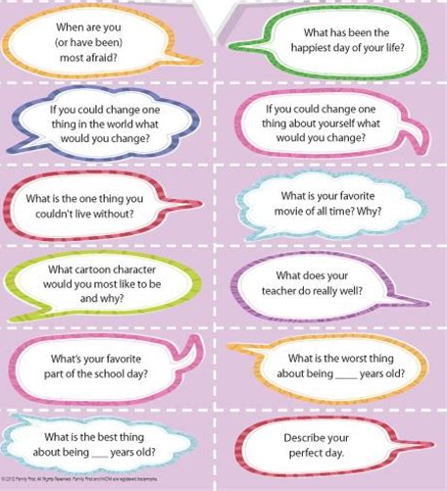

Slide 4
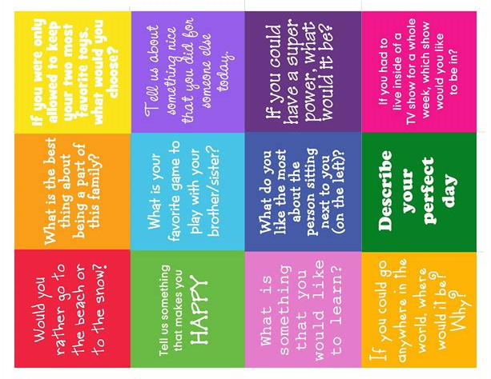

Slide 5


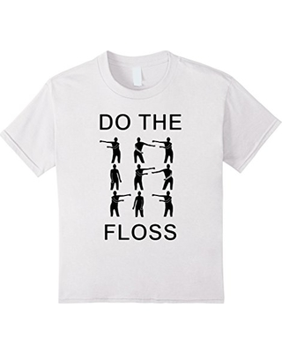
Move
How many ‘keepy uppies’ can
you do in a minute?
How many times can you
& a friend bounce and catch a tennis ball
Make a ‘superhero pose.’
How long can you do the
plank for?

Slide 6

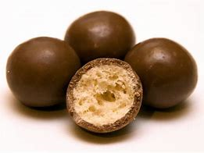
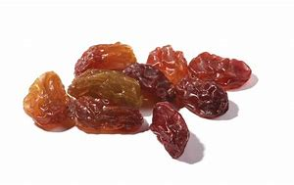
Interest (notice & be mindful)
First, look at the food Notice its texture. Notice its colour.
Now, close your eyes, and explore with your sense of touch.
What does this food feel like? Is it hard or soft? Grainy or sticky? Moist or dry?
Notice different aspects of your experience, using one sense at a time.
Before you eat, explore this food with your sense of smell. What do you notice?
Now, begin eating, take at least two bites to finish it.
Take your first bite. Chew very slowly, noticing the actual sensory experience of chewing and tasting. You might want to close your eyes for a moment to focus on the sensations of chewing ( or melting) and tasting, before continuing.
Notice the texture of the food; the way it feels in your mouth. Does it melt on your tongue?
Notice if the intensity of its flavour changes, moment to moment.
Now, please take your second and last bite.
As before, chew very slowly, while paying close attention to the actual sensory experience of eating: the sensations and movements of chewing, the flavour of the food as it changes, and the sensations of swallowing.
Just pay attention, moment by moment

Slide 7
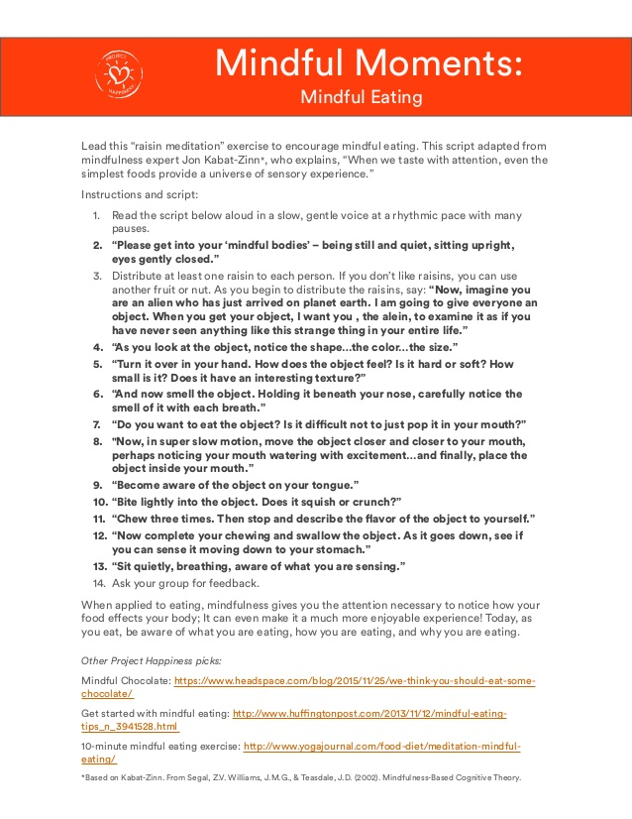

Slide 8
learn
Look at the new skill sheets and try one you haven’t before

Slide 9
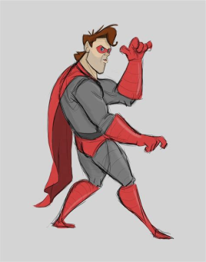

Create a superhero pose
Taking on a tall, expansive posture makes you feel more powerful than shrinking into a drawn-in position. Plus, the superhero stance releases confidence-boosting testosterone, so you'll literally, instantly get a hit of chemical confidence.
1.Find somewhere private (a bathroom or a closed office).
2.Stand up straight and lift your chin.
3.Hold the position for one minute prior to an interview, review, or public speech.

Slide 10
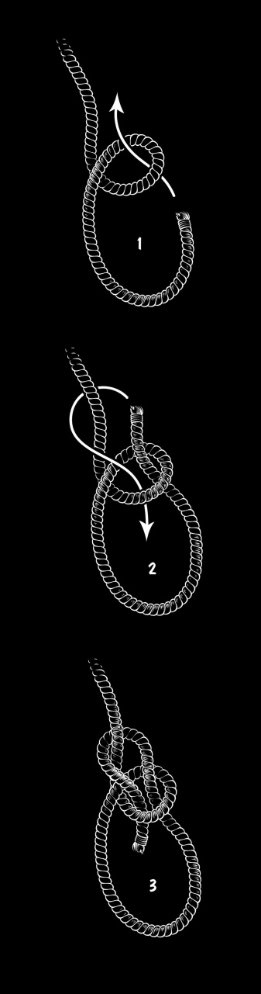
Tie a Bowline Knot
1.Create a loop.
2.Create a second loop behind the first and partially feed it through that first loop.
3.Pass the end of the line (fed through whatever you're hitching) through the tip of the second loop.
4.Tighten.
Illustrated by Christopher Wright

Slide 11
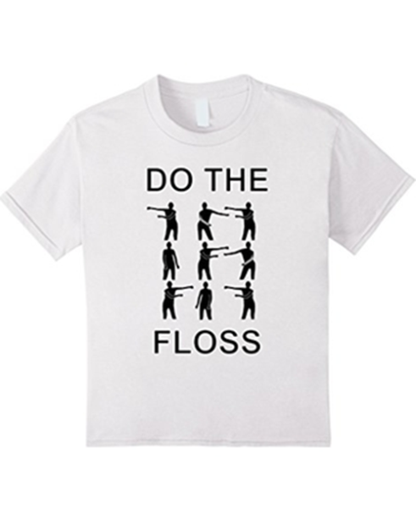
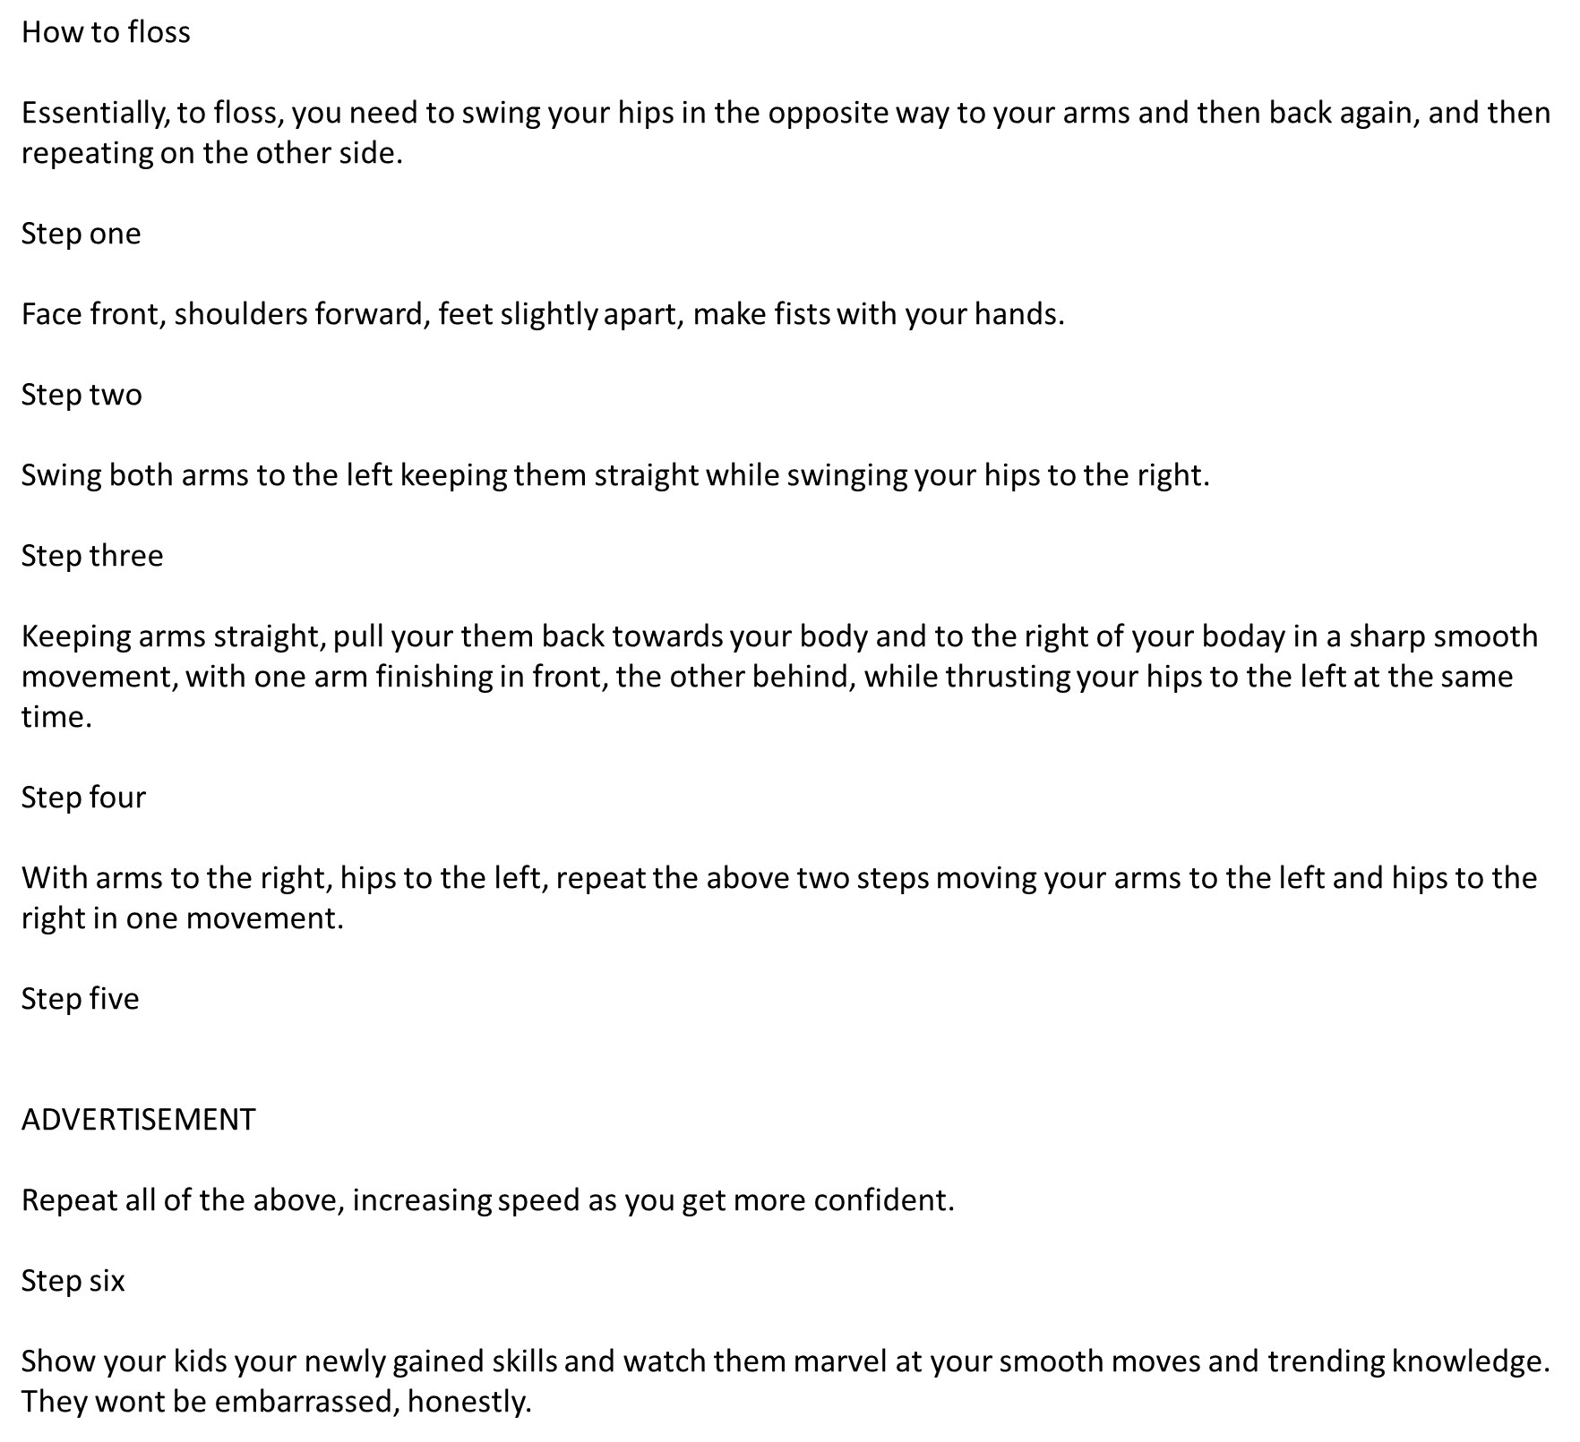
How to Floss

Slide 12
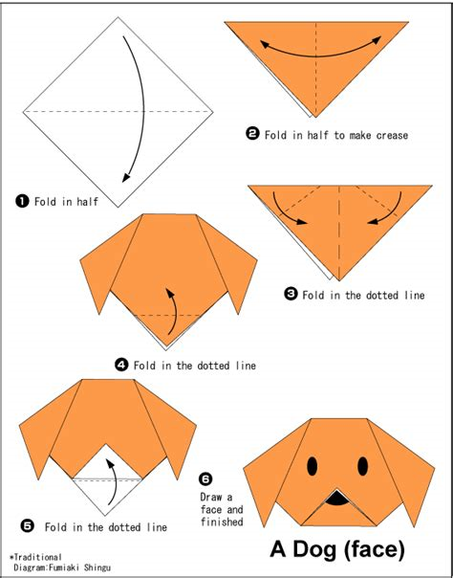
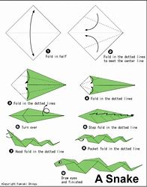
Origami..?

Slide 13

Engage with others
Discuss & select a random act of kindness you can do today; decide when, who & where & carry it out.
Take a smile token & write on it a compliment to someone else on the table. If you receive a compliment, perhaps write one back.

