Slide 1
End of Year 1 Schools’ conference
11th June 2019.
.

Slide 2
End of year 1 Conference
10:00 | Welcome | Amanda Mordey
10:05 | Project update | Issy Jerrard
10:15 | Staff Wellbeing | Amanda Mordey
10:30 | Project presentations | Barry Carpenter
(10 minutes for each school- discussion after each chaired by BC)
12:00 noon | Lunch (provided)
12:45 | Project presentations continued
1:45 | Next steps | Issy Jerrard
2:00 | Summary & close | Barry Carpenter

Slide 3

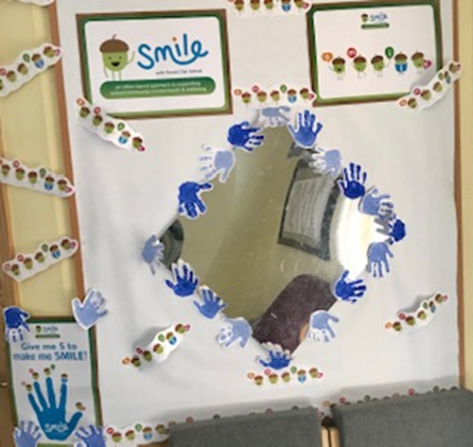
Intervention a chance to reflect….
Which classes were involved in piloting the new interventions?
What were they? When? Who?
What was timeline?
What evidence did you collect and when?
.
.
Notes:
Barry/Jo

Slide 4

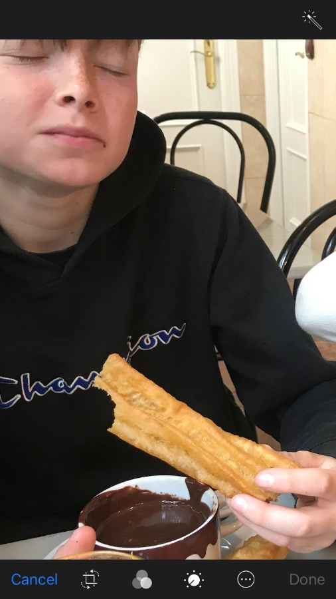
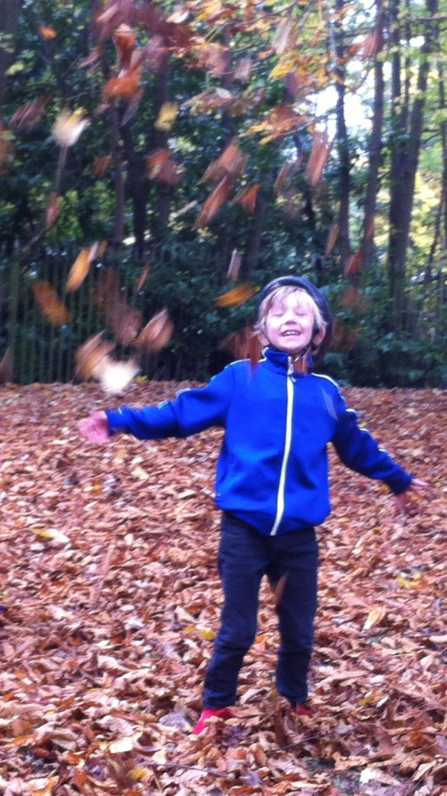
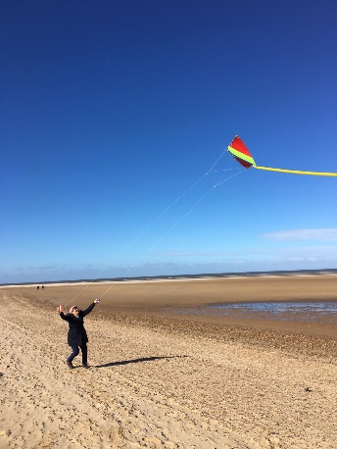
Reflect & share- how have you captured impact on wellbeing☺
Impact
How do you capture and share the impact
of interventions on wellbeing?
Maximise opportunities for moments
Moments as indicators & evidence

Slide 5


Reflect &
Common Issues
solution focussed thinking….
Wellbeing initiatives to support all staff…large teams, time, split sites, different needs & interests
Staff resistance & reluctance…
Ensuring this is not another add on or new initiative in a packed timetable for tired staff …
Driving a whole school approach when SLT busy or role change
Potential for confusion of with other approaches..(zones of regulation, zone board, pecs, emotion coaching)
I feel ‘ok’..... Do we need a resource for ‘ok’ as a content, resting emotion or should we encourage to identify, name & explore more than ok? (e.g. I’m fine)
noun Slang.
a situation, task, etc., that seems difficult or frustrating:
struggle bus

Slide 6

Wellbeing initiatives to support all staff interests/needs/base/hours

Slide 7
OK?

Slide 8
Staff resistance & reluctance

Slide 9
Not another add on in packed timetable

Slide 10
Driving whole school EHWB when SLT busy or role change

Slide 11
Confusion with other whole school approaches e.g. zones of regulation

Slide 12
EHWB support at home- sharing with parents

Slide 13
Staff wellbeing

Slide 14
Schools’ presentations

Slide 15


Slide 16



Slide 17
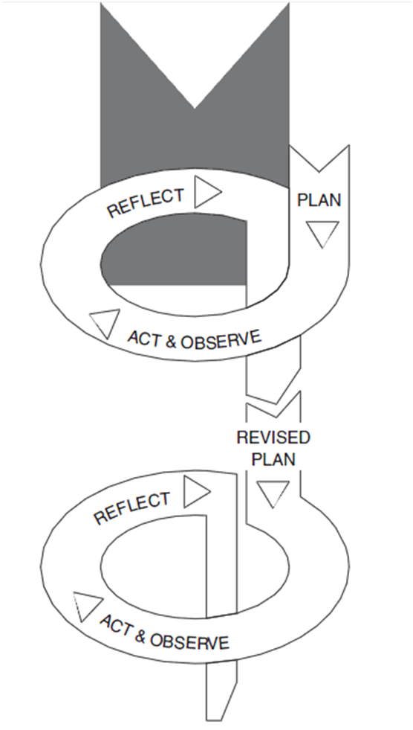
Next steps…..
Forest Oak-MLD
Merstone-SLD
10 schools-Primary, MLD, SLD
3 classes pilot
10 schools- whole school
Action Research Spiral
Kemmis and McTaggart (2000)

Slide 18

How do our discoveries relate to our practice?
Our School EHWB best hoped for outcomes
What has been said previously?
What did we know already?
Plan for whole school, y 2
Literature Search
Implementation
What do we want to know? How will we apply it to our practice?
Pilot interventions
Feedback to school
What ways can we investi-gate what we want to know?
How are
we going
to share our discoveries?
pre-end-pilot data suggest patterns impact
How are we going to gather the information?
Staff briefing & training, pilot class staff & pupil involvement & consents
Data
Analysis
WEMWBS questionnaires Observations
Incidents
feedback
Data
Collection
How are we
going to make sense of the information gathered?
How are we
going to involve people ethically in our research?
Notes:
Jo

Slide 19
Innovation – Next steps
How will we share the benefits of the new interventions?
…..Share….school wide impact……
Which have been the most effective new interventions for your school population?
Which ones are you going to roll out across the school?
How will we enable this?
  Explaining
  Training
  Mentoring
.
.
Notes:
Barry/Jo

Slide 20
Impact – what mental health issues are important for your school?
(What evidence did you collect and when?)
How will you present the evidence to convince school leadership/ teachers/ pupils of the intervention benefits?
What has been the impact of SMILE from project start to now?
What are your next steps?
.
.
Notes:
Barry/Jo

Slide 21
Next steps
We need to take this whole school….where do we start?... Prioritise & simplify for your unique SMILE community
“If you were to tell someone just two things to do to adopt the SMILE approach what would they be?”
Think of 2 things your school will start with for each:
Staff Pupils
1.___________________ 1.___________________
2.___________________ 2.___________________

Slide 22
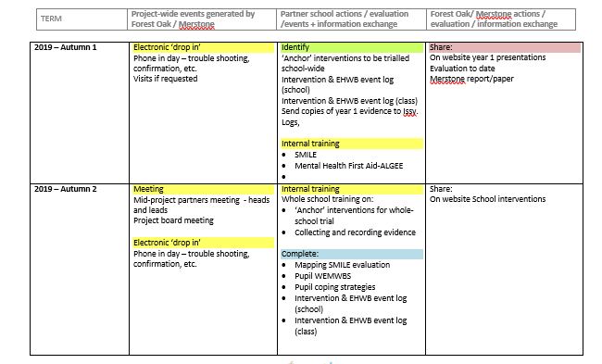
SMILE PROJECT TIMELINE ( 11.6.19).docx
WEBSITE
-Forest Oak
-SMILE
-Research
section

Slide 23
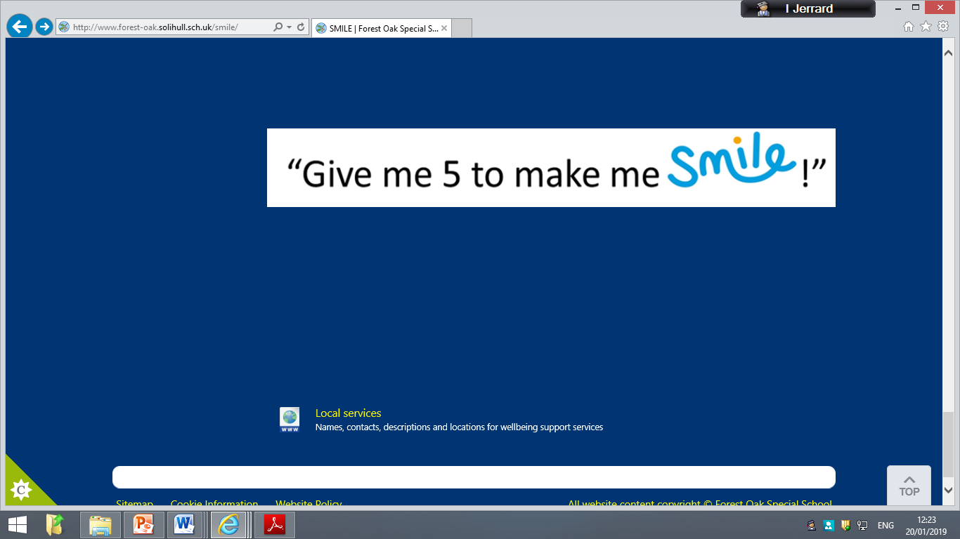
Final thoughts..
Consider whole school launch and keeping EHWB momentum in your community…
Who is driving EHWB? Are they supported?…
What support you will need from project team?…

