Slide 1
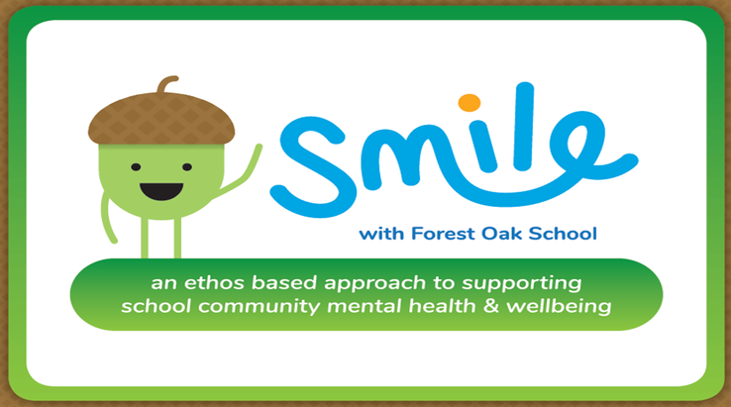

Agreed Priority Focus
Improvement in Emotional health and well-being in PMLD pupils
Improvement in Emotional health and well-being in SLD/ ASD pupils
Increase staff awareness of mental health issues and healthy coping strategies

Slide 2
Agreed Priority Focus
Evidence/ Data which could be used to illustrate these:
Target data based on EHCP sessions
Staff observations and pupil contributions using adapted WEMWBS sheets
Feedback from parents/ carers/ respite care
Intervention tracking
Staff WEMWBS contributions
Staff questionnaires
Feedback from training/ meetings

Slide 3
Original strategies
What did we call into question?
Staff wellbeing
The staff questionnaire indicated that staff felt more support and training were needed in regards to understanding and awareness of mental health and coping strategies
Which approaches/ strategies did we keep?
Our multisensory and holistic ‘child-centred’ therapies and sessions: sensory diets, physiotherapy, soft play sessions, music man sessions, etc
Monthly celebration assemblies: pupil of the month, golden moments, sports awards, etc

Slide 4
Launch
What did we adjust or introduce?
We made use of the staff questionnaire and WEMWBS responses to gauge areas of need at Old Park.
During our INSET day launch of the project we delivered training to staff to raise awareness and increase understanding of what Mental Health and wellbeing are; the kinds of factors which can have a negative impact on these; and what can be done to help improve it. During the day we also requested an audit of existing good practice relating to the five areas of SMILE.
Pilot classes were chosen to represent a cross section of the school, and initial assessments were completed to give an overview of each student involved.

Slide 5


EHWB empowerment
EHWB Issues
Focussed SMILE sessions on pilot class timetables
Staff meetings- opportunities to experience and explore the 5 areas of SMILE
Music man, soft play, sensory diets, Sherbourne, Physiotherapy, SaLT, Forest Schools, Swimming
SMILE inset & training
Well Done Assemblies:
Pupil of the month, sports awards, Golden moments
School council and PHSE sessions

Slide 6
Staff
For the staff team as a whole this year has been focussed on increased understanding of Emotional Health and Mental Wellbeing in general, through the use of a specific targeted INSET day and 5 designated staff meetings related to the 5 areas of SMILE. During these meetings staff had the opportunity to engage in such activities as a quiz, salsa class and personal reflection session.
The final session of the year will take place during an INSET day on the 22nd July, in which the staff questionnaires and WEMWBS surveys will be reissued in order to provide measurable data indicating the impact of the project so far in terms of staff understanding of mental health issues and possible coping strategies.

Slide 7
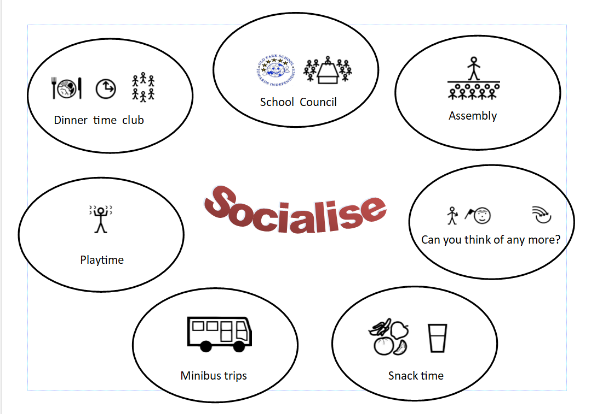
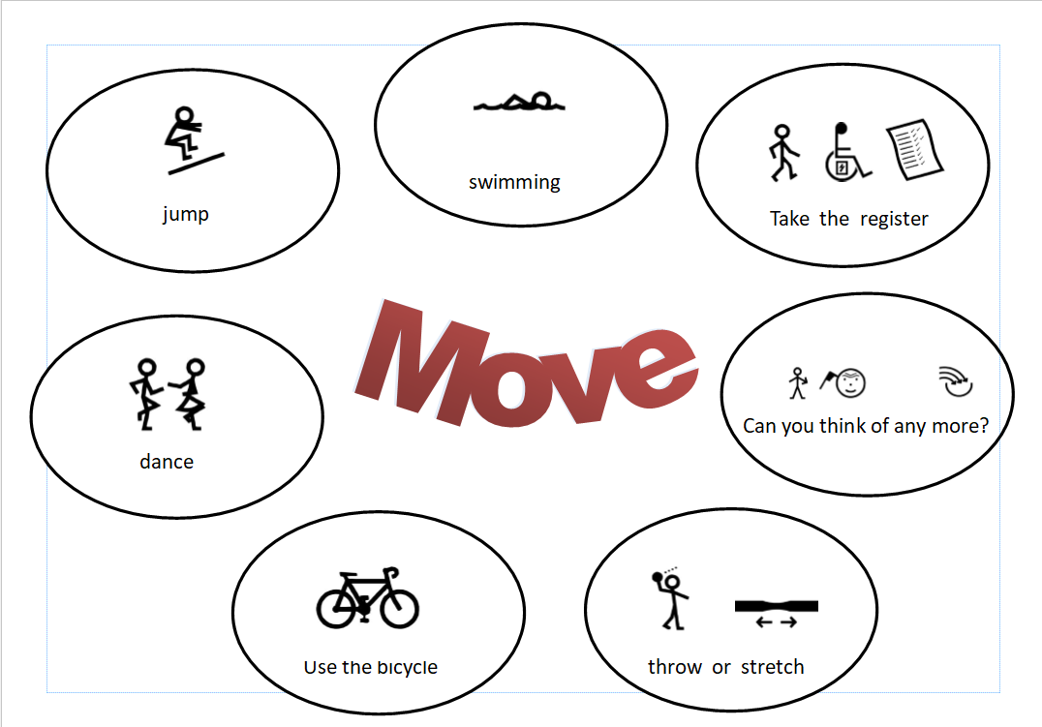
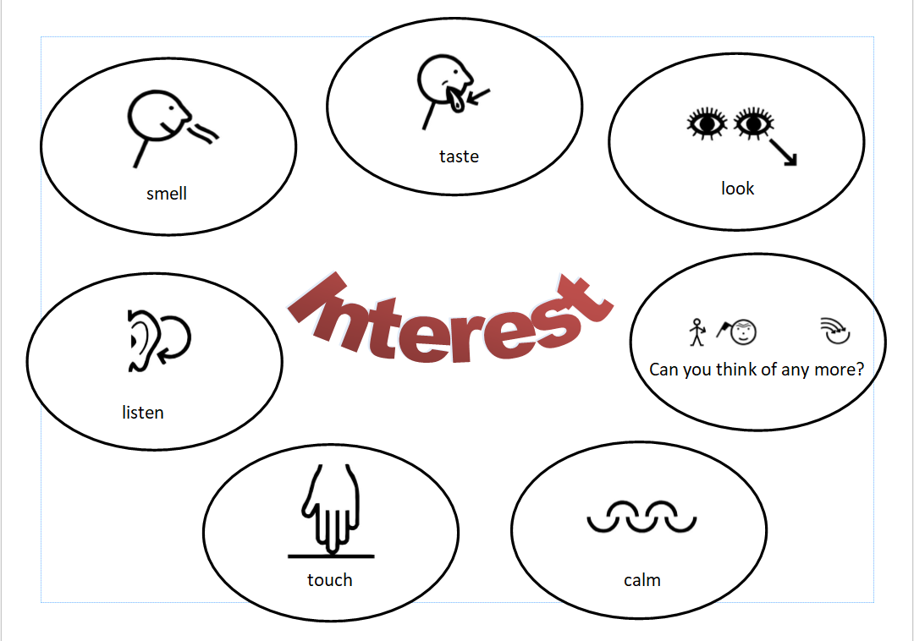
Students
School council meetings have been focussed on the five areas of SMILE this year to enable pupils to help each other share aspects of the project.

Slide 8
Students
Pilot classes chosen for assessment. Three focus students were chosen in KS2 and KS3, along with a class of eight Post 16 students.
-KS2 ASD/SLD class- move and engage have been the most effective sessions
Data so far:
Child 1: Average scores from autumn term were 1.9 Engagement, 2 Happiness raised to 2.2 Engagement and 2.4 Happiness in the Summer term
Child 2: Average scores from autumn term were 2.1 Engagement, 1.6 Happiness raised to 2.2 Engagement and 2.3 Happiness in the Summer term
Child 3: Average scores from autumn term were 2.1 Engagement which remained the same; and 1.8 Happiness raised 2.4 in the Summer term
-KS3 PMLD- move and socialise activities have led to the biggest responses witnessed by staff
Data so far:
Child 1: Average scores from autumn term were 2.4 Engagement, 2.9 Happiness
Child 2: Average scores from autumn term were 2.3 Engagement, 2.5 Happiness
Child 3: Average scores from autumn term were 2.1 Engagement, 2.6 Happiness
Summer term assessments are currently being completed for comparison.
-Post 16 ASD/SLD- Taking into account happiness and general engagement scores move and learn have been the most successful sessions so far.
Data so far: during wellbeing assessments 6 pupils scored average, 2 scored above average.
The wellbeing self-assessments will be completed again prior to the end of the academic year to indicate whether there has been a general increase in pupil scores.

Slide 9
Moving Forward
Formation of a staff wellbeing team.
Staff WEMWBS and questionnaires will be reissued during the INSET day in July to monitor impact of staff training. These will be reissued a final time at the end of the next academic ear in line with the end of the SMILE project to gain an overview of overall impact for staff.
Students- ‘SMILE time’ will be timetabled into each day as the unified approach, but adapted to suit the individual needs of each class.
To monitor the impact, each class will have either wellbeing self assessments or observational audits (as appropriate) to be completed term in order for averages to be obtained for comparison.
Assembly rota to feature SMILE themes

