Slide 1

Slated Row School

Slide 2
Introduction to Slated Row School
All-age, Moderate & Complex Needs School in Milton Keynes.
Based over 2 sites, with a cohort of 203 students.
4 times Ofsted Outstanding.
Teaching pathways: Structured, Sensory & Scaffolded (Lower, Middle & KS3).
Personal, Scaffolded & Employability (KS4 & Post 16).

Slide 3
Our Roles at Slated Row
Jonny Austin Assistant Headteacher
Mental Health & Wellbeing Lead
Cat Coventry Middle School Teacher
Smile Project Lead

Slide 4
is unique to every partner
Issue
Intervention
Impact
Innovation
Inquiry
The five ‘i’s (Carpenter, 2014)

Slide 5

Issues
Key Changes
Build on existing best practice and use established processes.
Building independence and life skills for students.
Increase awareness of staff’s own Wellbeing.
Empower staff, enabling them to best fulfil their role in supporting the students.

Slide 6
Issues
Key Mental Wellbeing issues for students
Mental Health and Wellbeing of students is key to learning.
Learning can only occur when students are fully engaged.
Without first ensuring students’ Mental Health and Wellbeing leads to engagement, learning cannot take place.
Students must thus be enabled to identify their own MHWB and equipped with tools to successfully manage it.
Highlighted the need to build on existing practice & develop ways in which emotional self-regulation can be embedded across the school.

Slide 7
Issues
Key Mental Wellbeing issues for staff
Detailed questionnaire carried out for all staff to complete
Only 1 person of 89 surveyed did not have a way in which they de-stress, with ¾ believing their process was effective.
Only 2 members of staff believed the school did nothing, with 84% of staff believing support was effective. The opportunity to talk, to feel listened to and that school systems supported staff were identified.
Regular opportunities for class meetings, fitness groups and social activities were all seen as desirable by staff.
Thus, whilst school structure supports, there is demand for “extras”.

Slide 8
Inquiry
Students and staff already had opportunities for developing MHWB, including emotional self –regulation, through:
Restorative tutor time & Circle Time
Happiness boxes
Zones of Regulation
The Well Being Team
Visuals / Cue cards
Staff training, inc. Team Teach
Student Voice
Development of break-out rooms
Music therapy
Many more…

Slide 9
Inquiry
We saw the need for two approaches to SMILE and SMILE-based work across Slated Row School
1. A whole school approach to Emotional Health & Wellbeing, with focus on students and staff
2. Research project into interventions a classroom level, to subsequently be adopted throughout school.

Slide 10
Inquiry
1. A whole school approach to Emotional Health & Wellbeing, with focus on students and staff
Whole-school INSET Day to introduce SMILE
A ‘Drip-drip’ approach to introducing SMILE across school
Distribution of SMILE Pack of materials for staff to use in tutor time
Assemblies to launch and develop SMILE with students

Slide 11
Inquiry
2. Research project into interventions at classroom level, to subsequently be adopted throughout school.
C. Coventry leading research project.
Focus to be on students’ self-regulation, through a sensory approach.
Focus on two Scaffolded middle school classes.
Use of Engagement Scales to ascertain success.

Slide 12
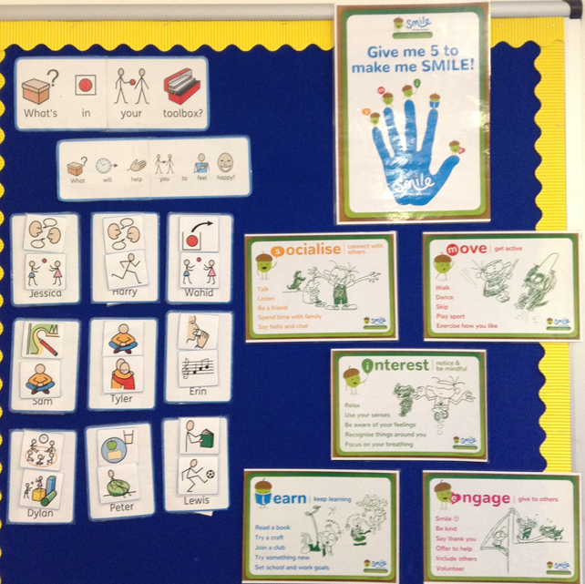
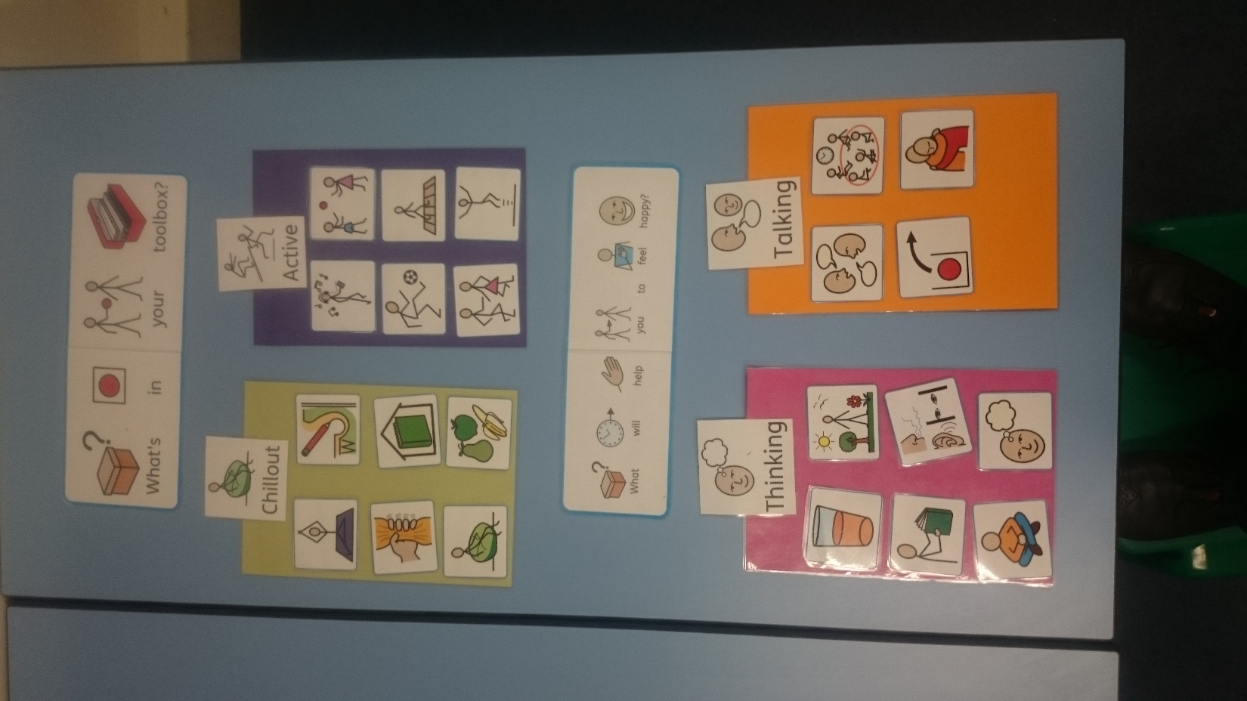
Intervention
Well-Being Toolbox
A provision which allows students to begin to develop their ability to identify and self-regulate their emotions.

Slide 13
Intervention
Well-Being Toolbox
Students identify those interventions which they recognise to be most beneficial to helping begin to regulate their own feelings.
Groupings discussed to ensure students find the most appropriate.

Slide 14

Intervention
Well-Being Toolbox
Students refer to and develop their use of their individual toolbox.
Toolbox is a working and evolving provision that students can self-refer to.

Slide 15
Intervention
Participating in the research project are:
Two Middle School classes, consisting of 10 students in each.
Both classes are Scaffolded classes, and thus approach curriculum in roughly the same way.
These classes have been developing their use of Wellbeing Toolboxes since March.
Whole-class development is observed by class teacher.
2 students from each class are being tracked using Engagement Scales.

Slide 16
Innovation
Impact of Wellbeing Toolbox has already been seen:
Engagement Scales of those tracked have clearly shown increased engagement with personal emotions and increasing ability to identify provision suitable for the student.
Students across the classes have been actively engaging in use of their Wellbeing Toolbox.
SMILE vocabulary has been increasingly used in class and referred to by students.

Slide 17
Innovation
Further Developments:
Initially, to be rolled out to the remainder of Middle School in September.
Will allow for Sensory and Structured adaptions to be investigated.
Following discussions with SLT, further INSET and whole –school launch.

Slide 18
Impact
The Journey So Far:
At a class level, we have seen increased engagement and development in self-regulation in regards to students’ emotions.
At a school level, we have seen an increased awareness of SMILE by students within tutor time / PSHE.
At a staff level, we trained and introduced the principles of SMILE to 89 members of staff.

Slide 19
Impact
Next steps:
1. A whole school approach to Emotional Health & Wellbeing, with focus on students and staff
Further development of SMILE Packs for all teaching staff.
Development of staff wellbeing to incorporate the “extra-curricular and social activities” identified.
2. Research project into interventions at classroom level, to subsequently be adopted throughout school.
Wellbeing Toolbox to be introduced into Sensory and Structured classes in Middle School.
Toolbox to be developed to ensure it can become a whole-school provision.

