Slide 1

Streetsbrook Smile

Slide 2
How we began our implementation
INSET for all staff to introduce the project
SLT – project was added to the SIP for 2 years
All staff completed the WEMWEBS and staff audit
Whole school audit of current provision/resources

Slide 3
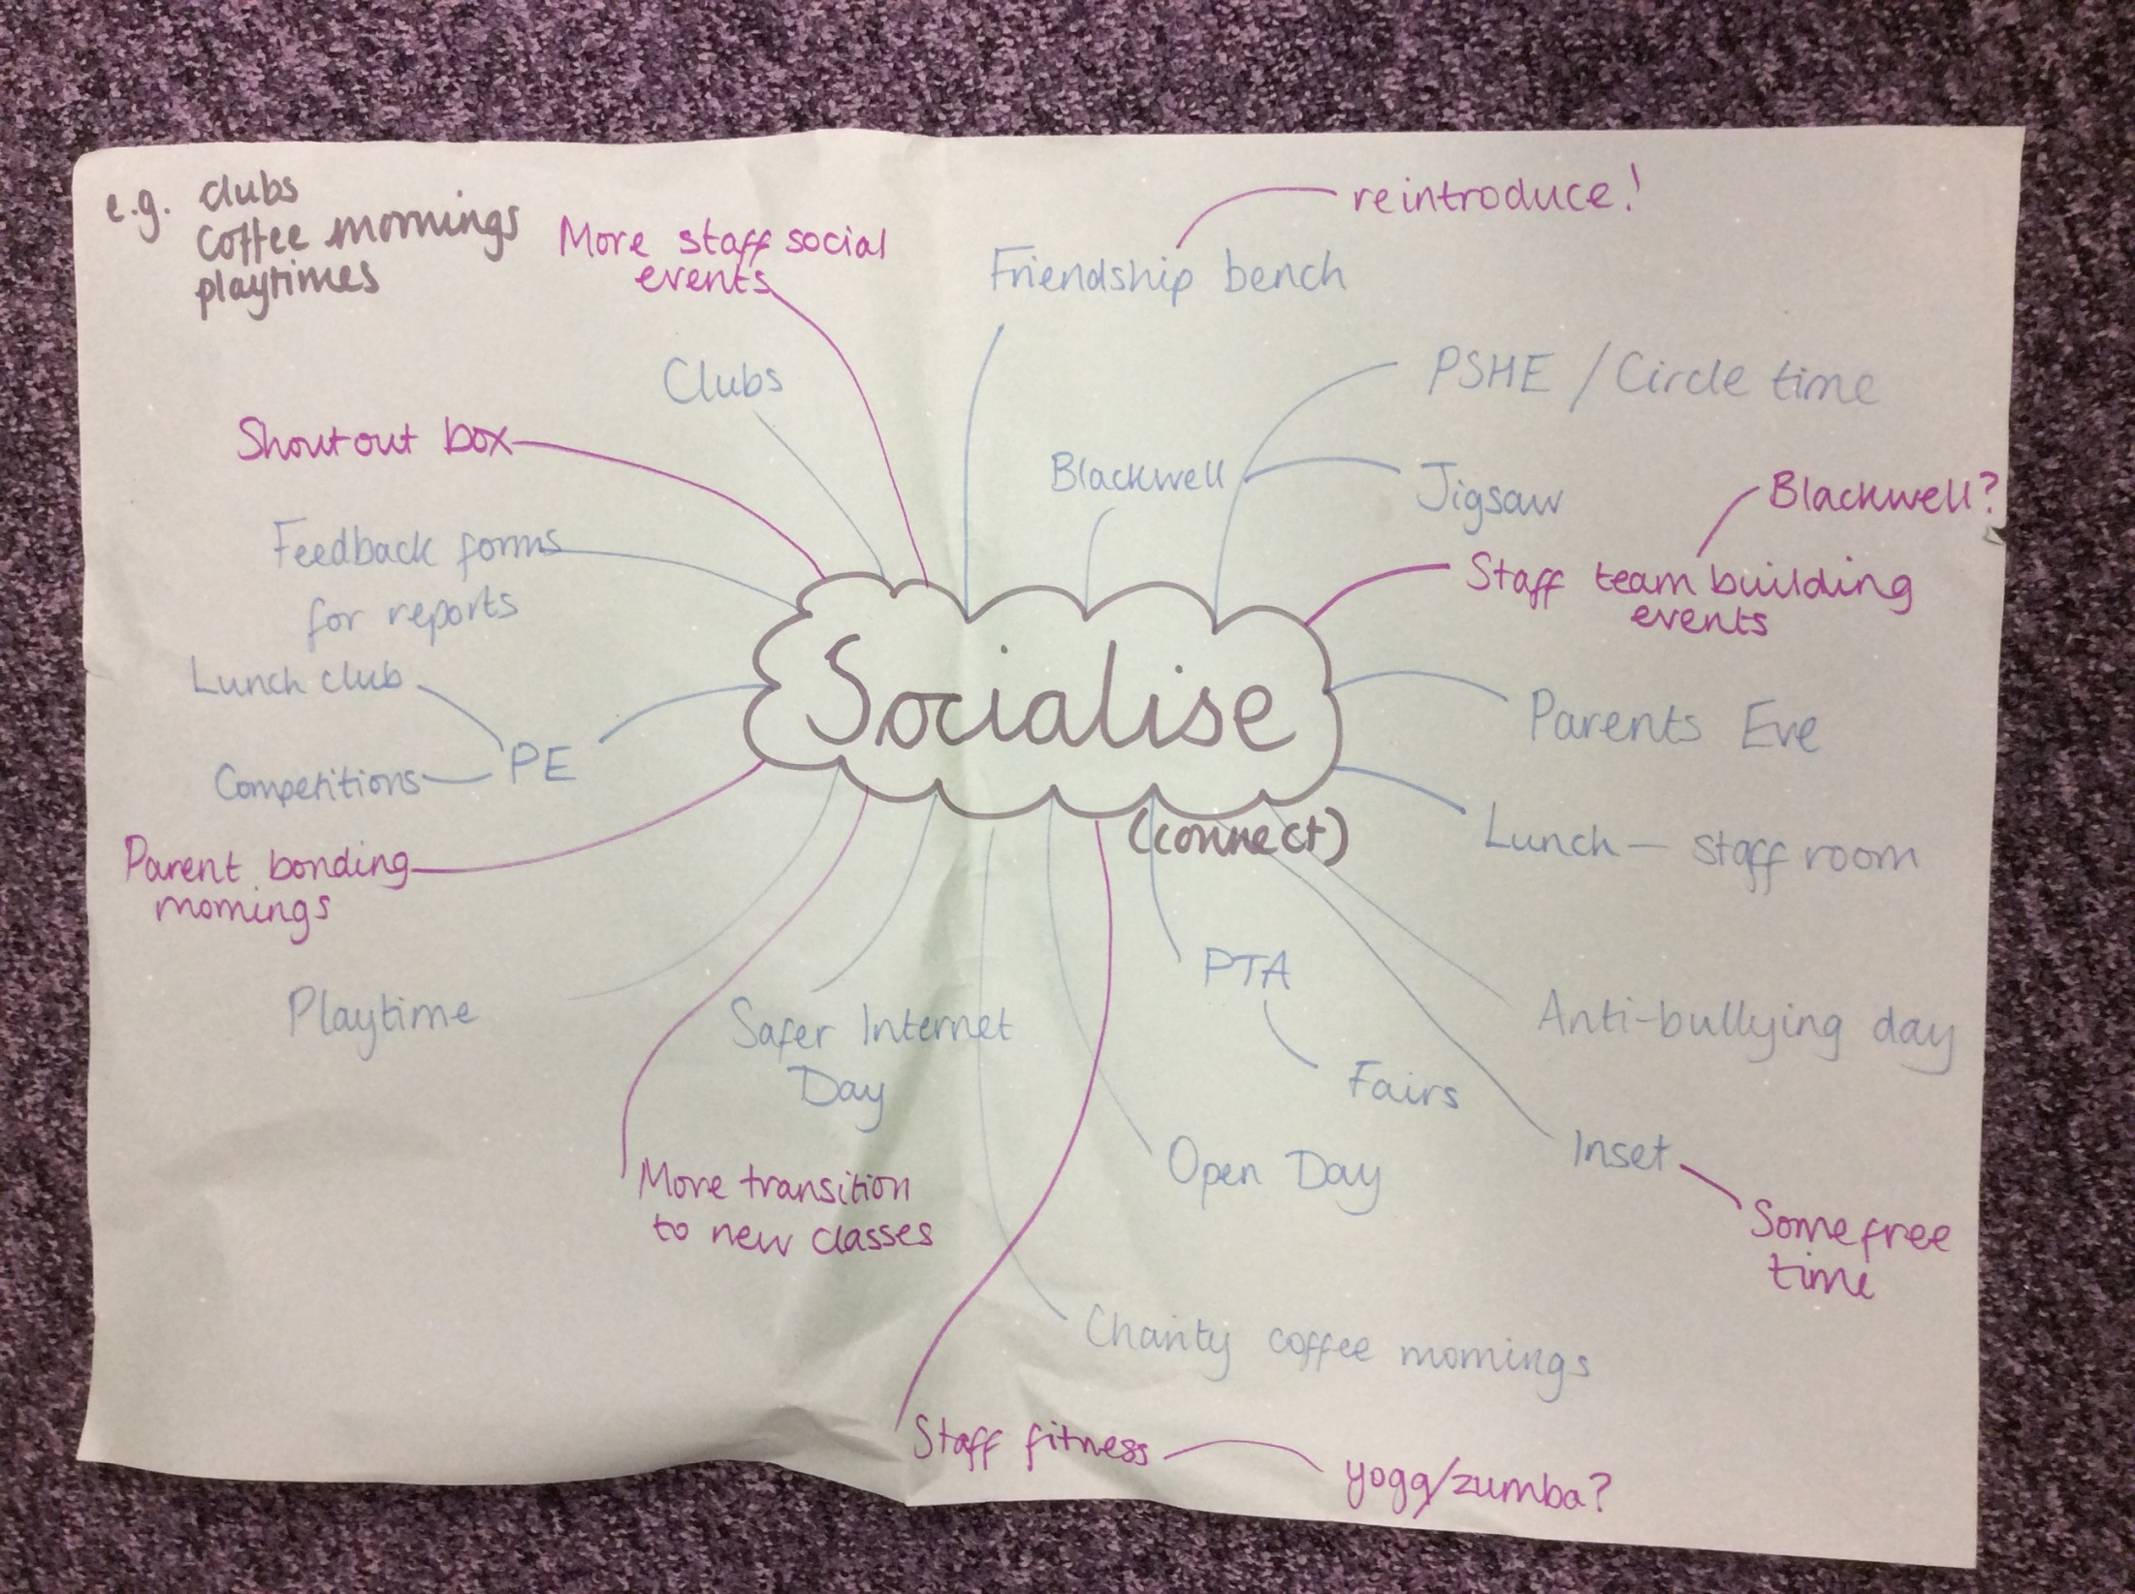

Slide 4
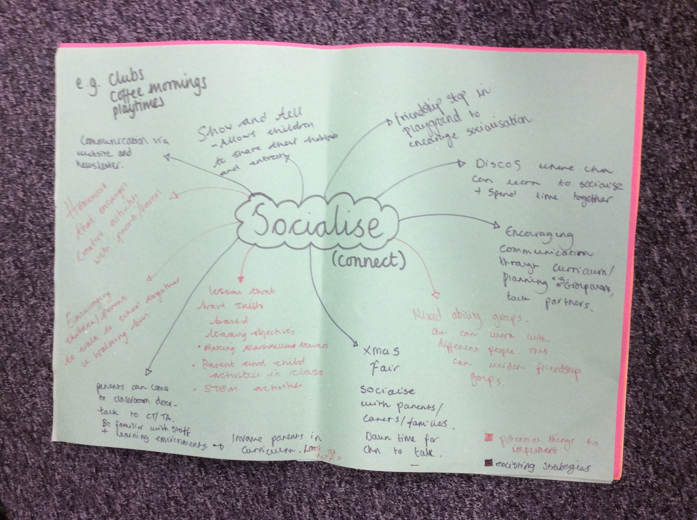

Slide 5
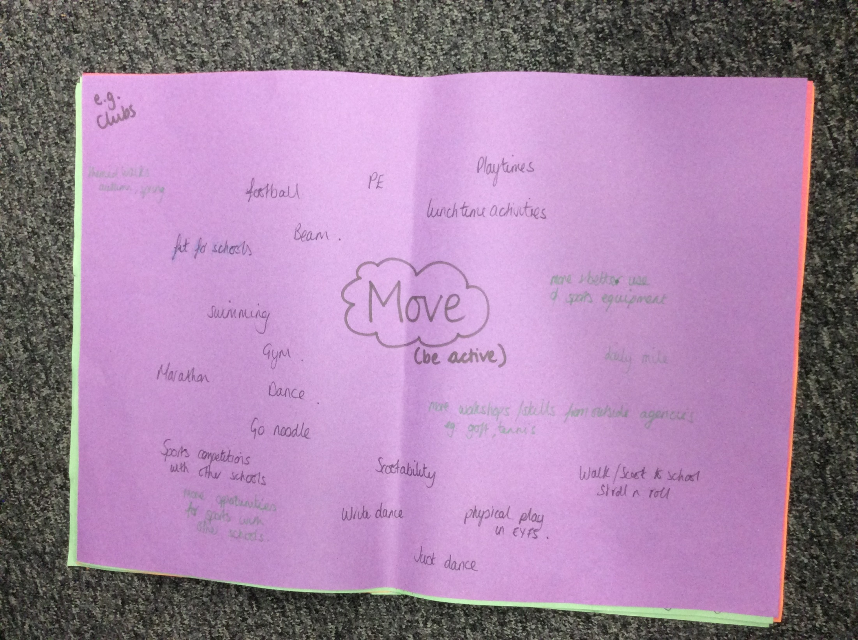

Slide 6
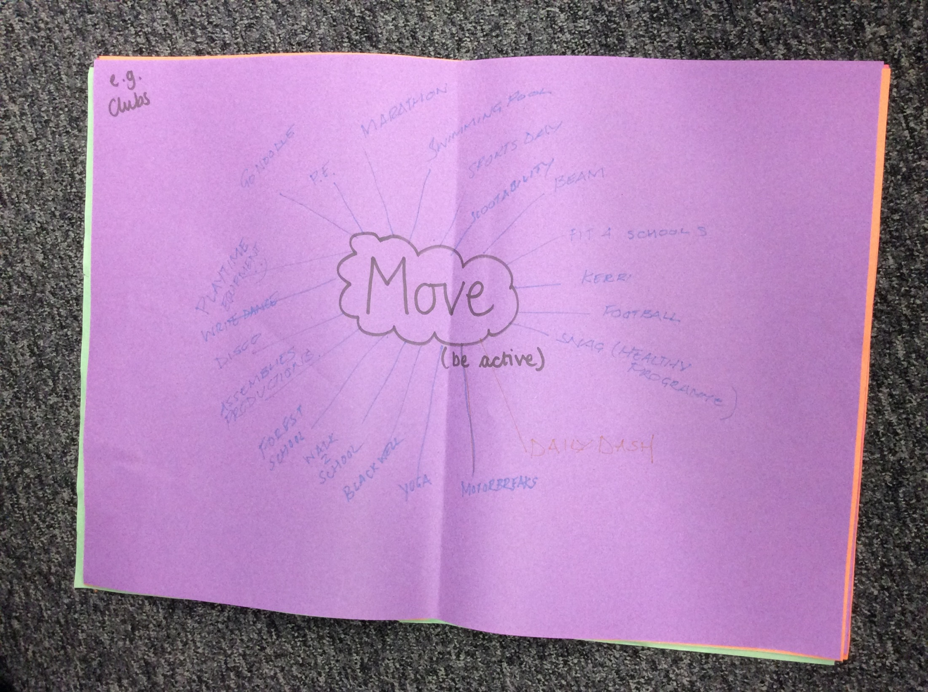

Slide 7
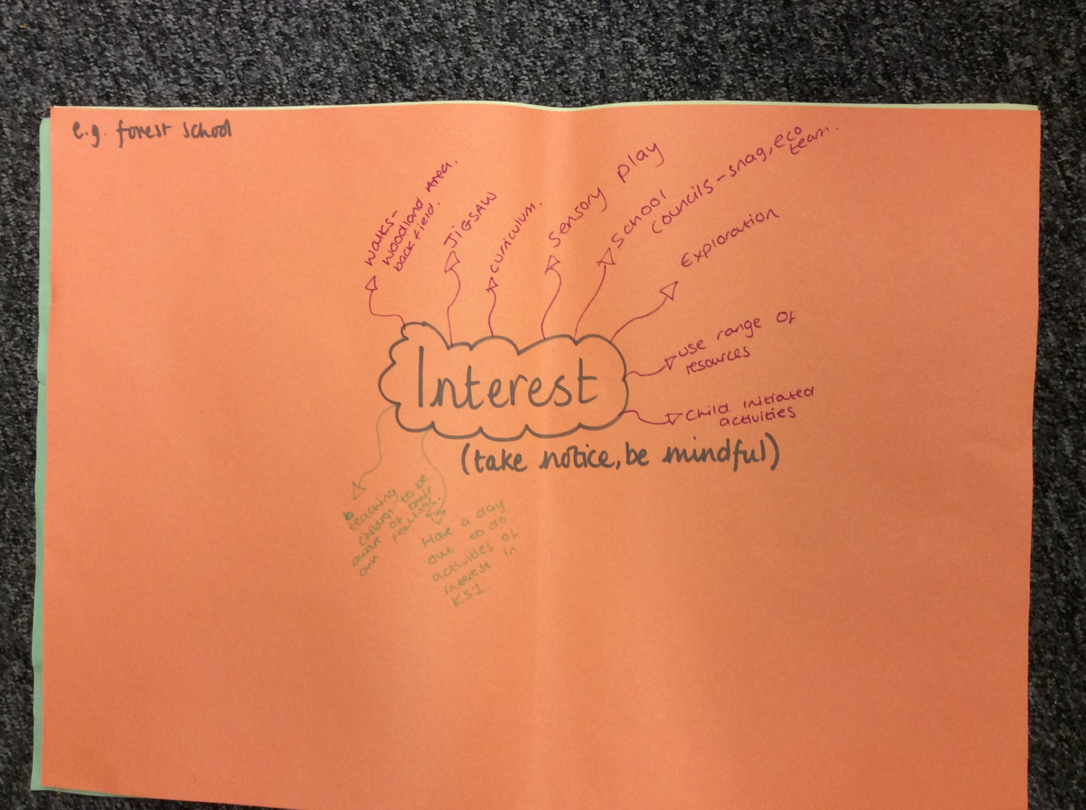

Slide 8
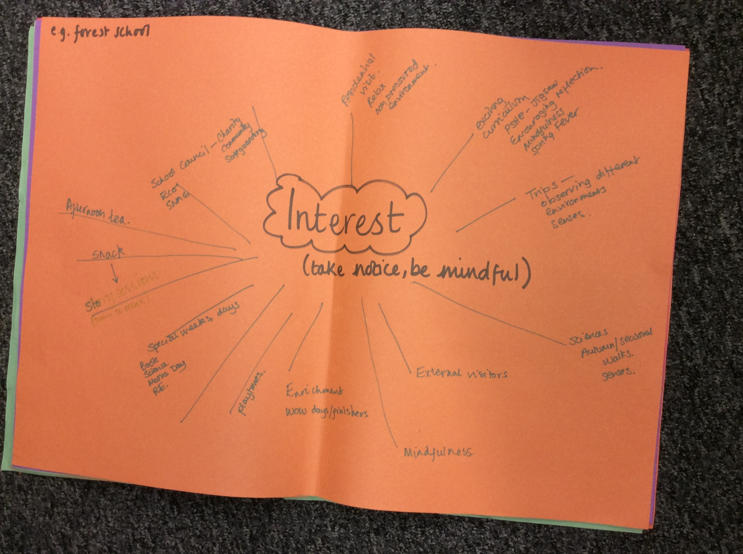

Slide 9
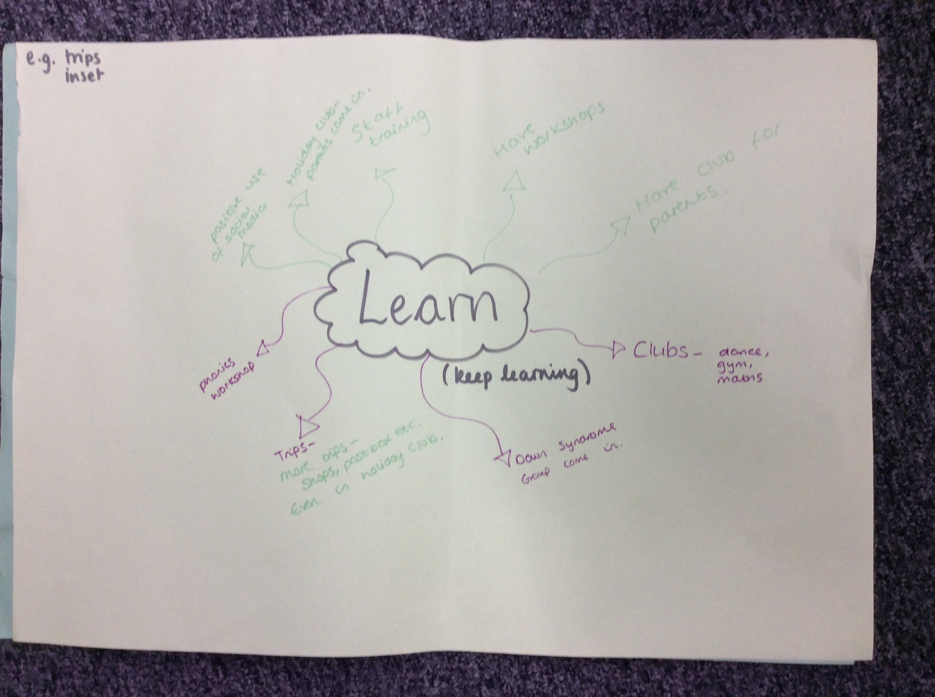

Slide 10
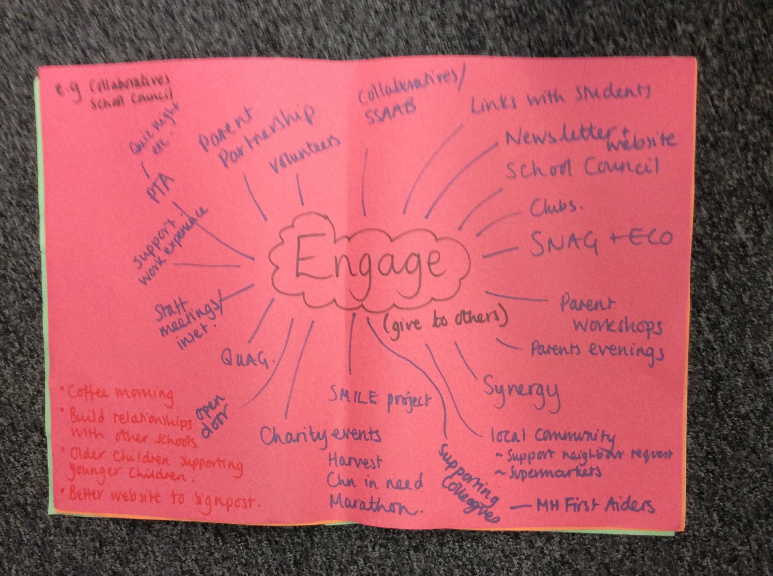

Slide 11
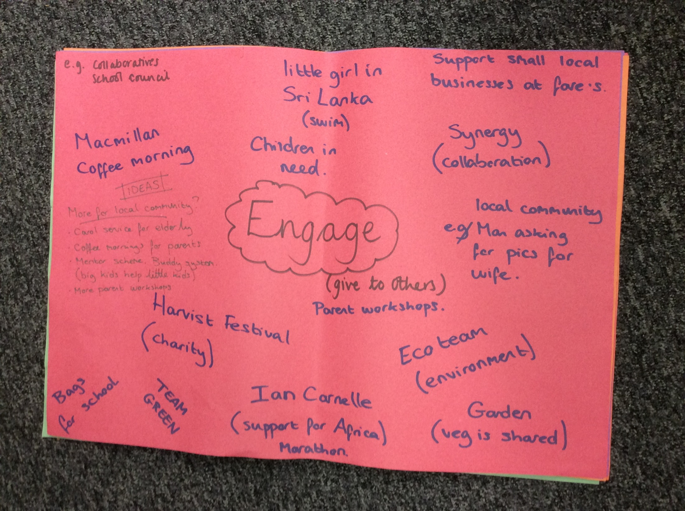

Slide 12
Priorities identified
SEE FOLDER

Slide 13
What we want to achieve
Acknowledge existing good practice
Whole school approach
Improved staff confidence when supporting children/colleagues with their EHWB
Support the wider school community
Embed mindfulness and identify more appropriate coping strategies
Increased access to appropriate resources

Slide 14
Data used to monitor outcomes
HRBQ survey – focus on the area of worry, activity levels and self-esteem
WEMWEBS
  Staff
  Children
Staff survey
Staff absence

Slide 15
Existing Resources
Mental Health First Aiders – ALGEE Approach
  Children/Youth x 4
  Adult x 2
WEMWEBS
  Staff
  Children
Accessible EHWB Policy and appendices
Butterfly Print SMILE Resources
Supportive SLT and Link Governor
PSHE – Jigsaw (links in mindfulness)

Slide 16
…continued
PSHE Lead attends termly Synergy meetings and sits on the Healthy Schools Quality Assurance Group
HRBQ survey
Healthy Schools status
SNAG team, including a link with ASDA looking at ‘food and mood’
Eco Team, who are introducing a sensory area and improving the school garden
Life Ready
Strong staff support ethos and skills

Slide 17
What have we done so far?

Slide 18
For staff
Whole school yoga lesson on INSET
Increased subject leader release time
Tidier PPA room!
SMILE Display
Book Basket in the Staff Room
Staff lunchtime walks
Encouraging staff to talk more

Slide 19
For the children
Launch Assembly
SMILE Display
SNAG - Food and Mood
Eco team – sensory garden and increased access to the gardening area
Empty classroom day – focus on SMILE theme
Open afternoon – each class to have a letter from SMILE
Results for interventions

Slide 20
Larger school community
Shared with Governors
Parents – letter home, SNAG team
Made links with Newlands Bishops Farm
Local supermarkets and school catering
EHWB area will be added to the school website

